Slide 1

A Brief Profile
Agrivet Research & Advisory Private Limited
(Formerly known as Agrivet Consultancy Pvt. Ltd.)
www.agrivet.in

Slide 2

About Agrivet Research & Advisory Private Limited
www.agrivet.in
Agrivet Research & Advisory Private Limited (previously known as Agrivet
Consultancy Pvt. Ltd.) started its journey in 2012 as a Technical Advisory
provider aimed to undertake technical and business consultancy services in
animal production technology for interested partner organizations.
Within a few days, the organization felt the latent need of creating a proper
scientific research facility in the field of “Poultry Nutrition” and decided to
establish another vertical, Agrivet Research Center, where the product
performance study is being conducted by Agrivet.
Agrivet Research Centre became an automatic choice for the established
multinational and Indian organizations to generate real, authentic, relevant
and detailed local data as a proof of concept for their extreme hard work in
New Product Development and ongoing product refinement.
Agrivet is an ISO 9001:2015 certified organization and provides Full Circle
Research Based Technical Solutions in the field of animal nutrition and health,
led by a team of dedicated technopreneurs.

Slide 3

About Agrivet Research & Advisory Private Limited
www.agrivet.in

Slide 4

Salience
www.agrivet.in
Integrated Multidimensional Research Facility
Grassroot Level Understanding of Animal Agriculture and Health
High Research Throughput resulting in Smart Delivery
Precision Output in Minimum TAT (Turn Around Time)
Driven by Experienced Technopreneurs
TurnkeyProject Consulting for Livestock Farming and Allied Services
Expert Livestock Advisory for varied climatic conditions
Presence throughout Indian Sub-Continent and South-East Asian countries

Slide 5
Salience
www.agrivet.in
250+ Global and Domestic projects handled
100+ satisfied clients throughout the globe
3 PhD, 6 Veterinarians, 4 Biotechnologists, 2 Microbiologists
Total 8 Laboratories to support the Research projects
Fully operational Broiler, Layer & Aquaculture research facility
Broiler Breeder research facility is under construction
Simulation of actual commercial broiler farm
State of the art Poultry Training School

Slide 6

Leadership
www.agrivet.in
Dr Shivaji Dey
M V Sc (Poultry Science), PGCBM (XLRI)
Being the founder Director, Dr Shivaji drives the organizational
strategies with major focus in areas of nutrition support through
formulation and corporate management. His expertise extends
to poultry, aqua, ruminant and swine nutrition, quality control
and assurance of cereal grains, Six-Sigma implementation in
plant process control and broiler integration etc. Dr Shivaji has
more than 23 years of experience in the field of Poultry Nutrition
and worked in areas of Poultry Breeding, R&D and Technical
Services with multinational giants like Kemin and Alltech. He is
presently involved as a senior consultant in poultry, soya, aqua
and dairy projects in one of the large Corporate Group in India
and provides technical supports in various capacities to the
poultry industry spanning in many countries of South Asian
regions including India, Bangladesh, Nepal, Sri Lanka, Thailand,
Vietnam, Malaysia, Indonesia and Japan.

Slide 7

Leadership
www.agrivet.in
Dr Sudipto Haldar
Ph D (Animal Nutrition)
Dr Sudipto started his career as a Animal Nutrition
professional in the year 1997. He worked as an Assistant
Professor of Animal Nutrition in WBUAFS and was associated
with research projects mainly on gut health of poultry and
developing feeding strategies for broiler chickens free from
antibiotic growth promoters. The other focus area of his work
during this period was application of enzymes in poultry. He
published more than 60 scientific papers and was invited as a
key speaker in different scientific forum at international levels.
Dr Sudipto worked as the Technical Manager of AB Vista-UK
and led the R&D division of a large Corporate Group in India.
Dr Sudipto is heading the Research vertical of Agrivet with his
enormous experience in dealing with new challenges and
inquisitiveness to work with out of the box hypothesis. Apart
from the R&D, Dr Sudipto provides nutritional and business
operational supports to clients in India, Nepal, Bangladesh
and Bhutan.

Slide 8

Leadership
www.agrivet.in
Dr Anirvid Sarkar
M V Sc (Genetics & Breeding), PCPGM (IIM-Kozhikode)
Dr Anirvid is an expert on macro and micromanagement of
livestock business operations like supply chain management, QA &
QC, breeding, hatchery management, feed milling, import,
procurement and commercial activities, laboratory operations etc.
Dr Anirvid has specialized in conceptualization and implementation
of all styles of greenfield projects by effectively assisting the
entrepreneurs in poultry and livestock sectors. Dr Anirvid has 19
years of experience in areas of broiler breeder technical
operations, hatching eggs & chicks business, techno-commercial
positions in additives marketing, heading poultry feed
manufacturing business etc. He looks after the commercial,
strategies, project design, execution, feed mill management &
audit, quality control of grains in India, Bangladesh, Nepal and
other SEA countries. Dr Anirvid is instrumental in establishing the
state-of-the-art research infrastructure of Agrivet experimental
farm embracing modern technology installed in every routine
function of R&D.

Slide 9

Leadership
www.agrivet.in
Dr Amrita Dhara
M V Sc (Veterinary Epidemiology & Preventive Medicine)
Dr Amrita started his journey in the field of poultry breeding
in 2004 with Venkateshwara Hatcheries Pvt. Ltd., a renowned
pure line poultry breeding company in India. He looks after
the disease prevention and control management, production
efficiency management and other technical aspects of poultry
breeding, commercial broilers and hatchery operations. He
has gained experience through working in production house
of broiler breeding farm and layer breeding farm of
Venkateshwara Hatcheries in North India. Dr Amrita was the
technical service provider to the broiler breeding farms under
VHPL in Eastern India and Bangladesh. He has expertise in
epidemiology, prophylaxis, disease diagnosis and treatment,
setting up broiler breeding and commercial farm projects in
different agro-climatic conditions of North India, Eastern and
North-Eastern part of India, Nepal, Bangladesh and other
South Asian countries. His expertise in managing Poultry GP
operations has also been recognized by the industry.

Slide 10

Leadership
www.agrivet.in
Dr Arindam Chatterjee
BVSc & AH, PGDM (LIBA-Chennai), MCP (IIM-A)
Dr Arindam is a Management Professional with more than 20 years
of experience of working in Animal Agriculture Industry. He fell in
love with the spirit of Entrepreneurship when he was pursuing his
PGDM from Loyola Institute of Business Administration (Chennai).
During his further management education in IIM-A he picked up
the nuances of enterprising ecosystem in Business Organizations.
Dr Arindam is well known as a risk taker, passionate team builder
and a fast learner. During his professional career spanning two
decades in various MNCs and Indian companies Arindam
demonstrated his core expertise in building start-ups, scaling
businesses and managing P&L responsibilities.
Dr Arindam is presently associated as a Strategy Architect and
trying to help Agrivet grow the CRO activities, Analytical &
Diagnostic Lab Services, Skill development training institute and
exploring other new business opportunities.

Slide 11

The Team
www.agrivet.in
Md. Monirul Islam
Anindya Maitra
Dr Sayantani Sihi Arora
Dr Arpana Verma Mukherjee
Arup Nayak
Head - Operations
BA (General)
Head of Farm operation, Farmers Training
Head - New Market Initiatives
Head - Research Laboratory
Manager - Research Laboratory
Manager - Research Laboratory
Manager - Research Farm
Manager - Operations
B Tech (Production)
Ph D (Biotechnology)
New Market Initiatives
Research Lab service
Ph D (Animal Biotechnology) Industrial Research service
M Tech (Biotechnology)
B V Sc & AH
Lab Services, Research Services
Research Services, Lab Services
Coordination, Operations
Dr Sk Md Kamrul Hasan
Dishari Dutta
B Sc (Botany)
Jeegyasha P Kanungo
Sudita Basak
Executive - Research Laboratory
Executive - Research Laboratory
Executive - Research Laboratory
Executive - Research Laboratory
Executive - Research Laboratory
Manager - Quality Control
Executive - Research Laboratory
Executive - Feed Milling
M Sc (Biotechnology)
M Sc (Biotechnology)
M Sc (Coastal Aquaculture)
M Sc (Bioinformatics)
B Sc (Chemistry)
BA (General)
Lab Services, Research Services
Lab Services, Research Services
Laboratory Coordination, Operations
Lab Services, Research Services
Lab Services, Research Services
RM Inspection, Quality Assurance
Lab Services, Research Services
Feed Plant Operations
Ankita Purkayastha
Indranil Haldar
Sourav Maity
Amlan Sarkar
Satya Gopal Dhara
Sourav Sen
Diploma - Electronics
B Com (General)
Diploma - Mechanical
-
Tapas Jana
Technician - Feed Milling
Feed Plant Maintenance
Biswajit Haldar
Executive - Feed Milling
Feed Plant Operations

Slide 12
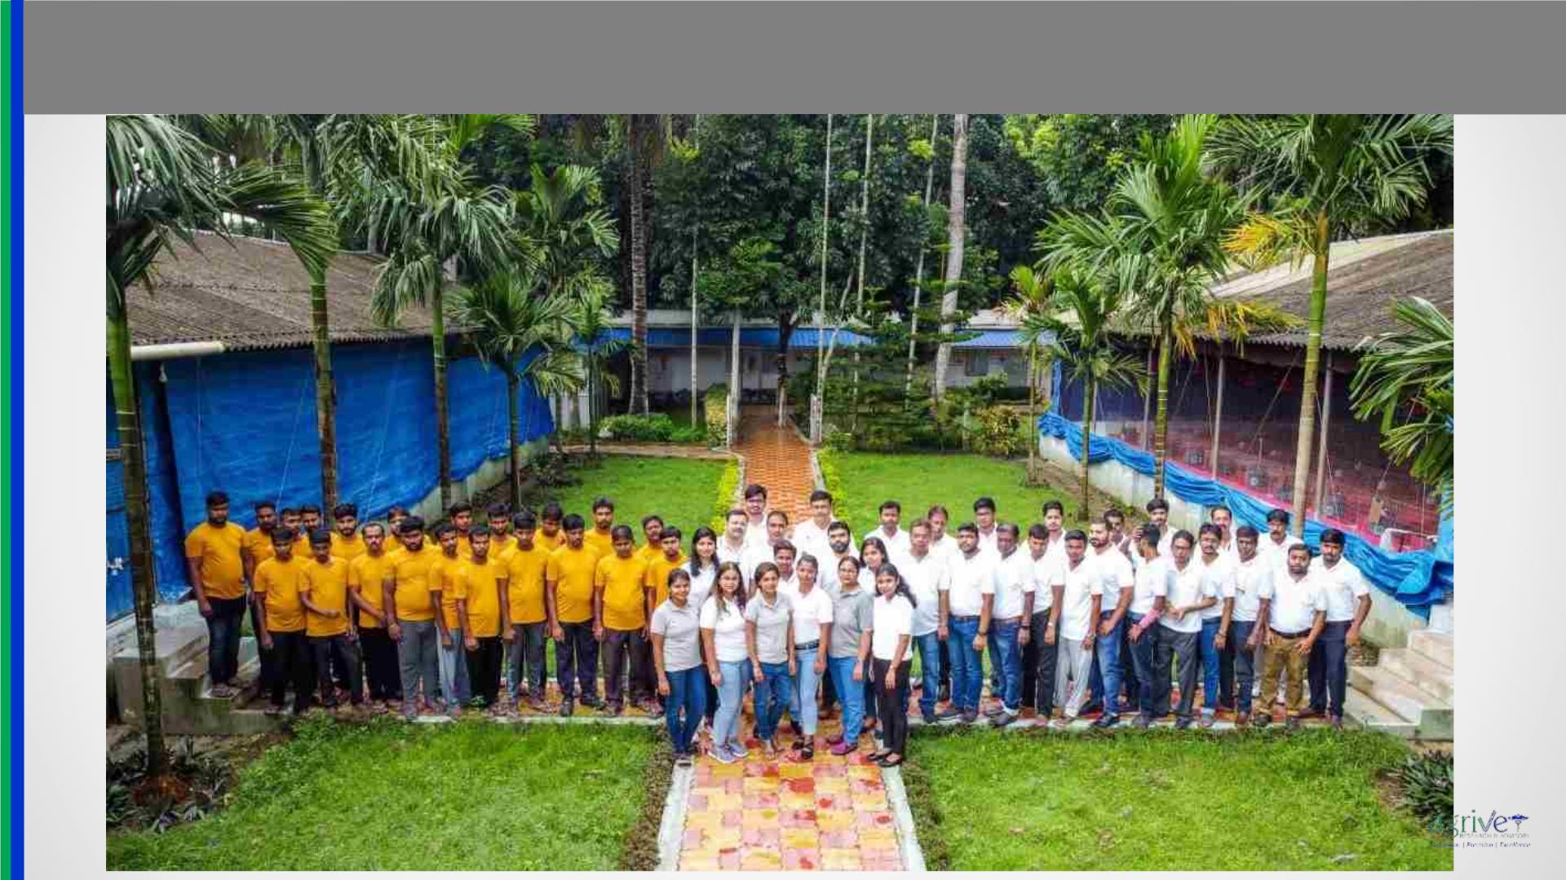
The Team
www.agrivet.in

Slide 13
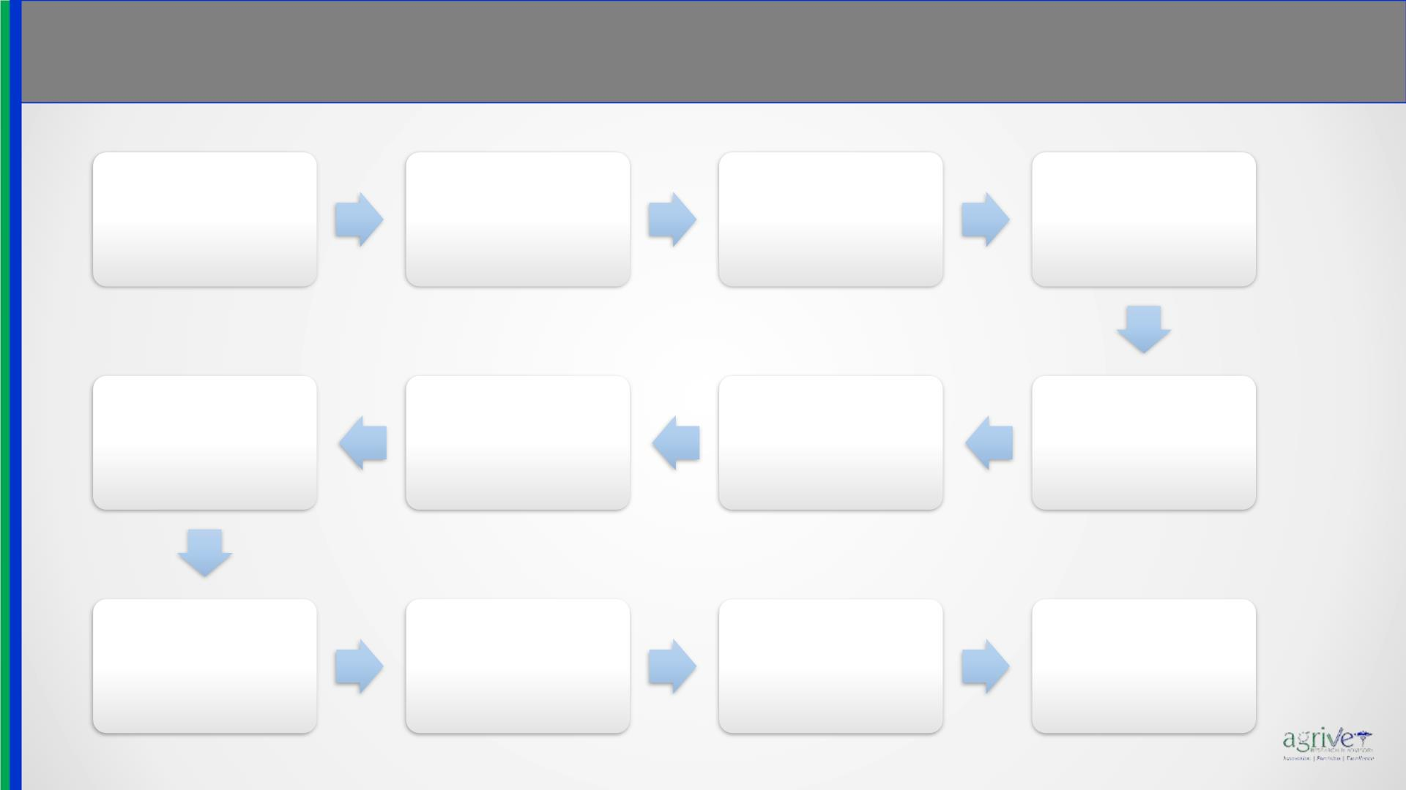
Momentous
www.agrivet.in
2012
2013
Onset of Agrivet Research
with basic performance
study on commercial
broiler
2012
2012
First Domestic Research
Project
First Overseas
Consultancy assignment
New facility started at
GLB with enhanced
capacity
2015
2015
2013
2016
Established exclusive
Mash Feed Plant for
research feed
Completed 50 research
projects at Agrivet facility
Expansion of Facility in a
new state of the art
Research Complex at DGN
Started FIRST Commercial
Layer research facility in
India
manufacturing
2016
2017
2017
2017
Placement started at the
new DGN facility with all
modern amenities
Introduction of Meat
quality, drip loss and
other carcass parameters
study
Started wet chemistry
laboratory for inhouse
proximate analysis
Assessment of Tibial
dyschondroplasia and
Tibia Breaking Strength

Slide 14

Momentous
www.agrivet.in
2018
2018
2018
2018
Introduction of poultry gut
study models to enumerate
NE, Cocci and Dysbiosis
Introduction of circulatory
biochemical study using
blood analyzer
Setting up State-of-the-art
pellet feed manufacturing
facility for research
Introduction of NIRS analysis
of RM and Finished Feed
2018
2018
2018
2018
Started total tract and
marker based Ileal
digestibility studies
Thermal Imaging of birds
and internal organs
Introduction of serum
biomarker assay using ELISA
Histopathological studies &
microscopic photography of
internal organs
2018
2019
2019
2020
Introduction of “Specialized
Stress Study Model" with
heat, toxins, bacteria and
coccidia
Table Egg processing facility
including walk in chiller was
established to supply eggs .
Inhouse Microbiology
laboratory started
functioning
Established Advanced
Nutrition Laboratory using
auto analyzers

Slide 15
Momentous
www.agrivet.in
2020
2020
2021
2020
Setting up Molecular
Biology and Metagenomics
laboratory for livestock
research
First private lab offering
Genomics Services in
Animal Biotechnology in
Eastern India
Aquaculture research facility
is under construction”
Bagged the first
international project on
“Metagenomics”
2021
2021
AGRIVET CONSULTANCY
Is now
2021
2021
Expansion of Digestibility
and Metabolic Trials to a
whole new Unit
Aqua Research Facility starts
it’s operation
AGRIVET
turns 10
AGRIVET RESEARCH &
ADVISORY
2021
2021
2021
2021
Laboratory Facility
strengthened and opened
for use by Livestock Farmers
Completed 200
Research Projects
India’s First
DIGITAL EGG TESTER
arrived from JAPAN
AGRIVET is
ISO 9001:2015
Certified Company

Slide 16
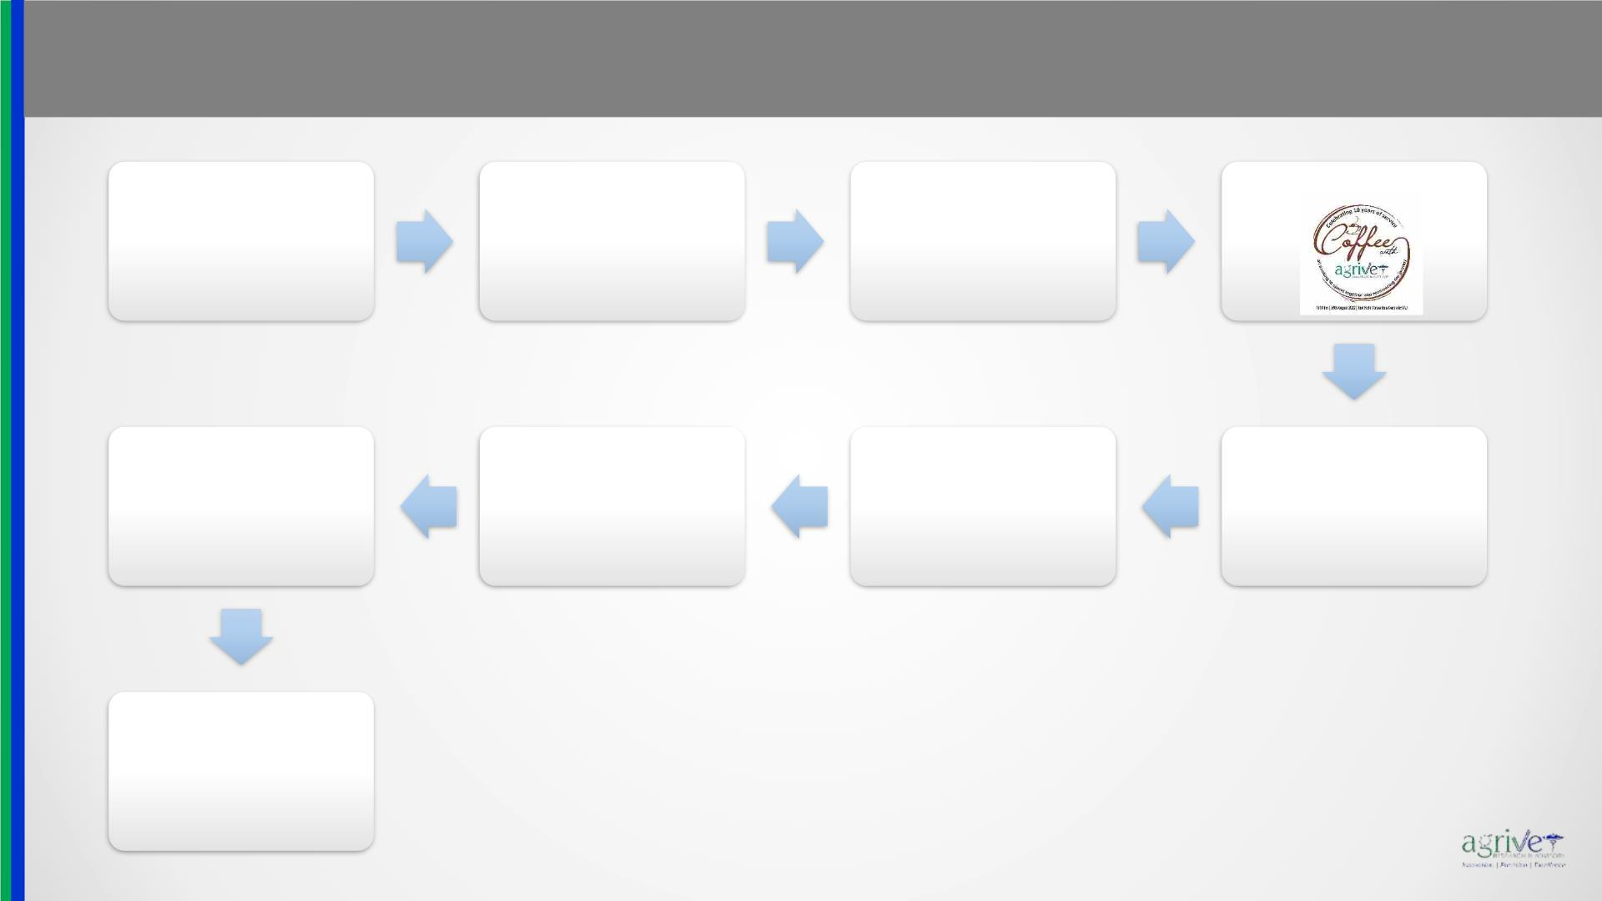
Momentous
www.agrivet.in
2022
2022
2022
Agrivet has become pioneer
in offering “Molecular
diagnosis of bacterial and
viral diseases” to the
livestock industry
2022
Started Industrial Training and
Internship programmes for
students
Completed 225
Research Projects
2023
2023
2022
2022
Started Re-skilling and Up-
skilling of human resources
through Agrivet School
Participated for the first time
in Kolkata International
Poultry Fair
Construction started for
Research Facility with Broiler
Breeders
Environmentally Controlled
Broiler Research Facility
started it’s operation
The journey continues

Slide 17

About Agrivet Research & Advisory Private Limited
www.agrivet.in
Agrivet Services:
Agrivet
Research
Agrivet
Advisory
Agrivet
Laboratories
Agrivet
School

Slide 18

Capabilities: Research
www.agrivet.in
Agrivet Research:
• Agrivet is India’s only Independent Private Livestock Contract Research service
provider with 100+ Indian and Global clients.
• At Agrivet Research Center, basic and applied research is carried out for benefiting
the livestock fraternity across the globe.
• Agrivet research facilities are systematically designed and ideal for
research planning and perfect representation of current farming scenario in
tropical countries.
• The experimental station consists of, two research farms, equipped with state-of-
the-art facilities, integrated with feed plant, meat processing facility & laboratory
services.
• The Corporate office and Biotechnology laboratory are located in Kolkata while the
experimental stations are about 45 minutes’ drive from the NSCBI Airport.

Slide 19
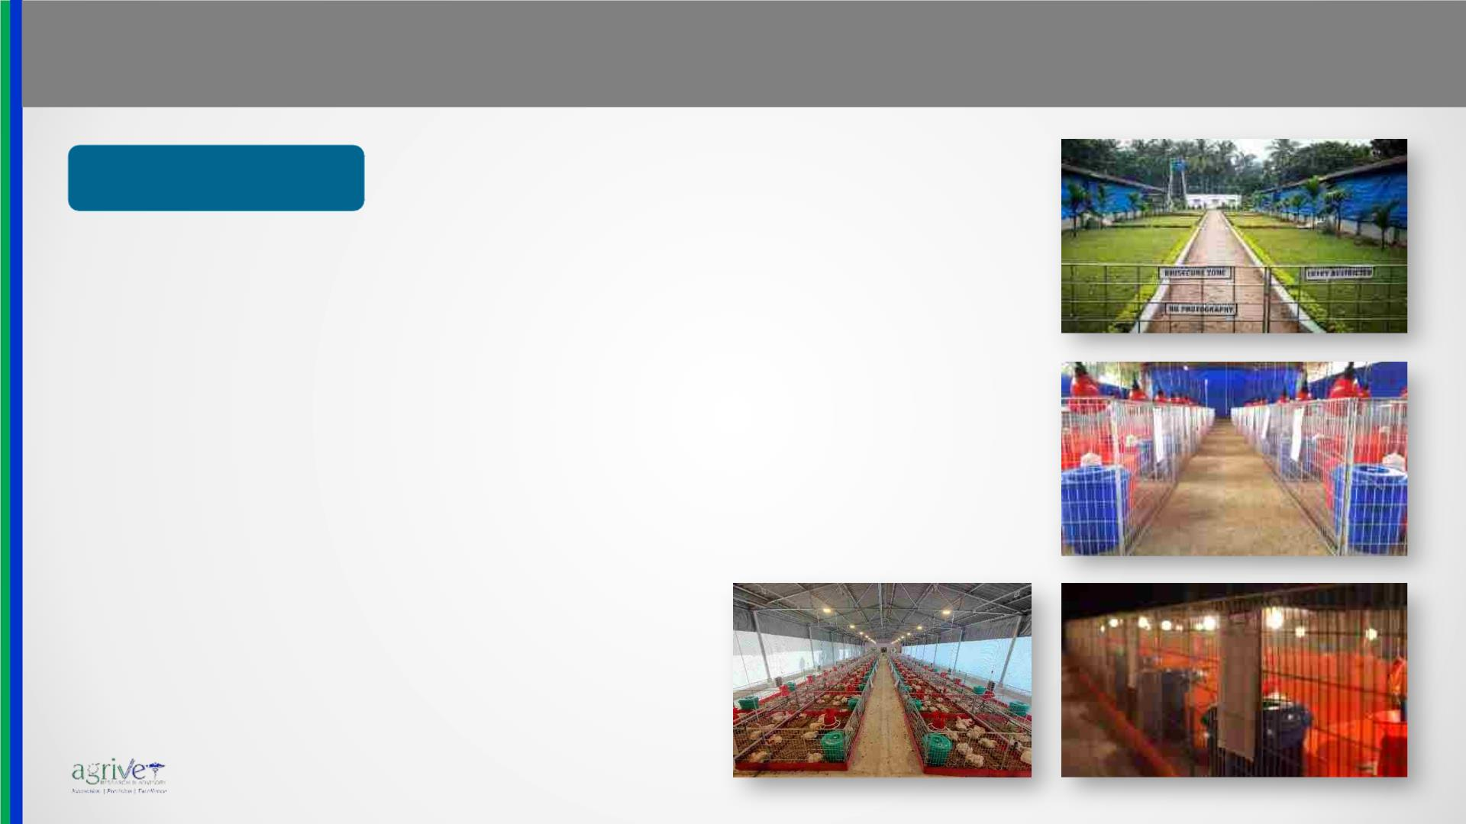
Capabilities: Research
www.agrivet.in
Poultry Research:
• Commercial Broiler:
• Broiler Performance study
• Stress study with Microorganisms, Heat, Mycotoxins
• Metabolism trials
• Carcass evaluation
• Blood Biochemical & Haematological profile
• Histological parameters
• Immune parameter studies
• Internal organ monitoring
• Leg health and bone mineralization studies
• Metagenomics & Gene Expression Studies

Slide 20
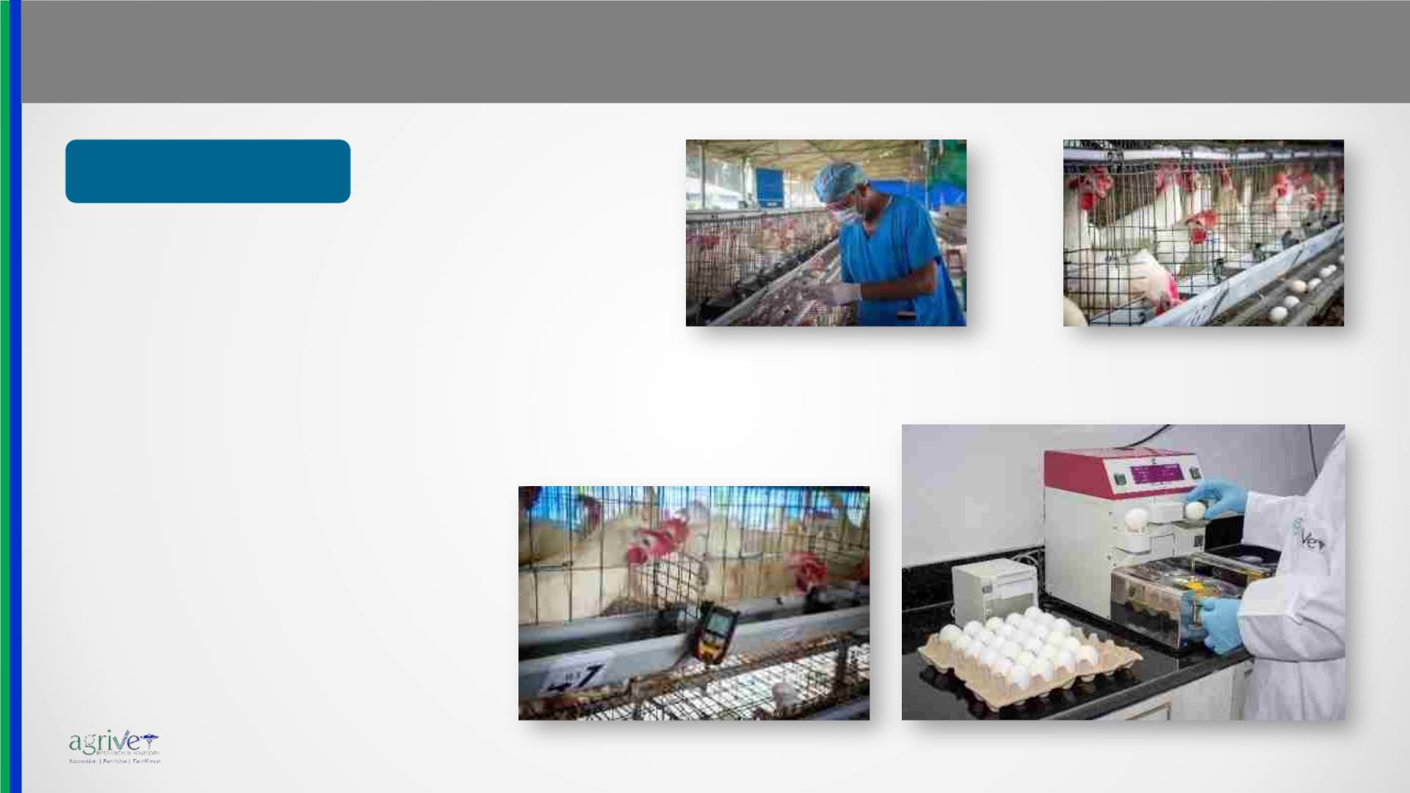
Capabilities: Research
www.agrivet.in
Poultry Research:
• Commercial Layer:
• Layer Production Performance study
• Study combining Growing and Laying phase
• Gut health study
• Body weight, Egg production, Feed
consumption, FCR, Mortality
• Egg weight and Egg mass
• Measurements of Haugh Units
• Yolk pigmentation (YCF 4 to 15)
• Strength of Shell
• Shell thickness

Slide 21
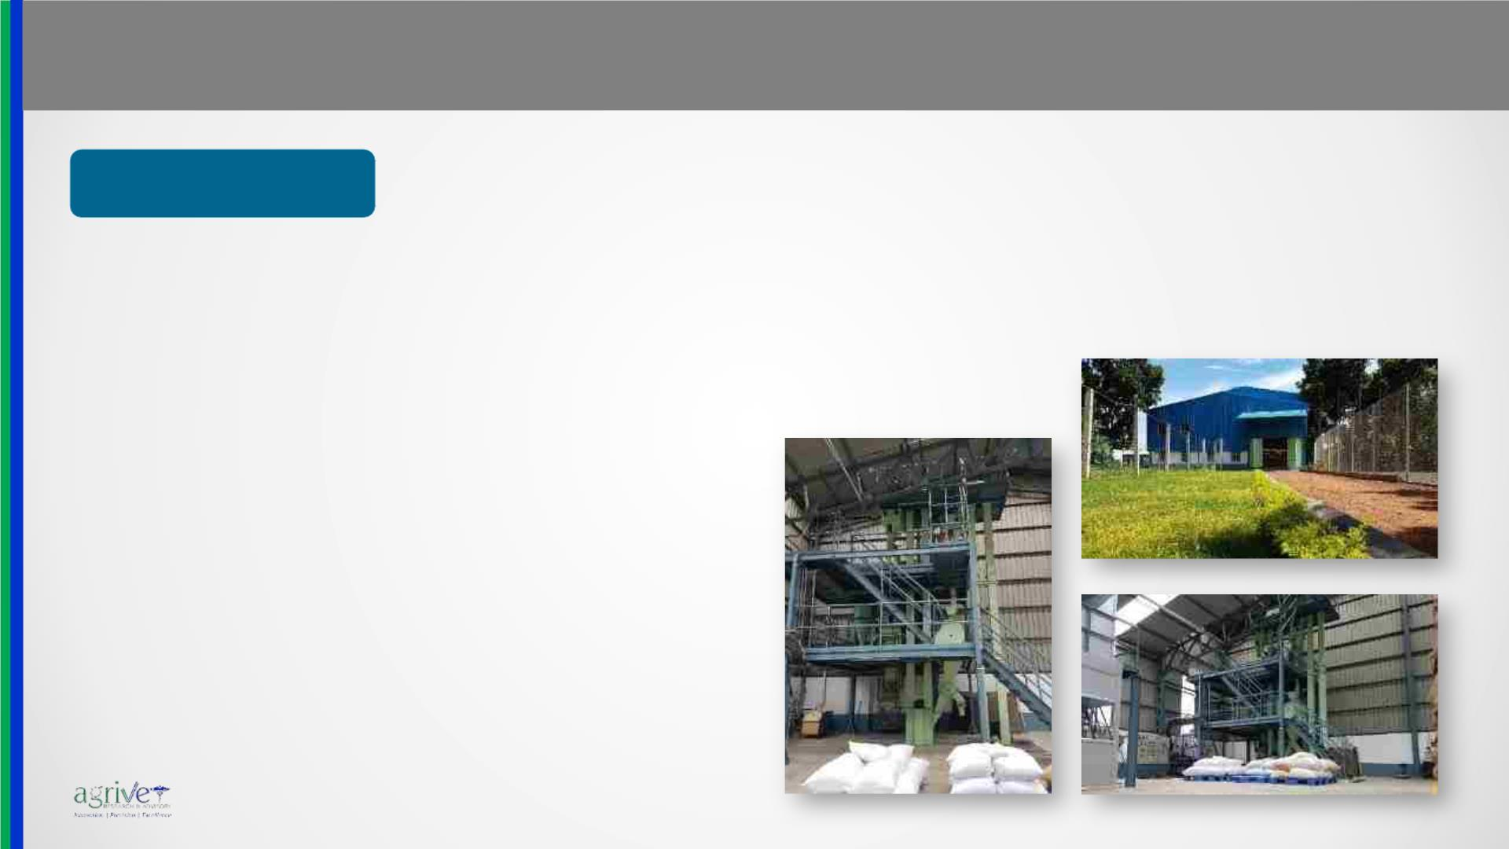
Capabilities: Research
www.agrivet.in
Poultry Research:
Study of Feed Production parameters:
• Pelleting parameters
• Feed Milling:
o Pellet Durability and hardness.
o Particle size distribution analysis.
• Measurement of pelleting throughput.
• Pelleted feed manufacturing unit (capacity:
100kg/h)
• Mash feed manufacturing unit (capacity:
100kg/h)
• A precision premixing facility is available
where additives in small quantities are added
into the final batch following progressive
dilution technique through a 6 kg and 20 kg
fine mixer.
• Vast choice of ingredients to formulate diets
as per the need of research is available.

Slide 22

Capabilities: Research
www.agrivet.in
Broiler Breeder
research:
• Agrivet is coming up shortly with a state of
the art Environmentally Controlled Broiler
Breeder Research Facility.
• This is going to be Asia’s First privately held
art Environmentally Controlled Broiler
Breeder Research Facility.

Slide 23

Capabilities: Research
www.agrivet.in
Aqua Research:
• Agrivet has created and standardized the first modern indoor aquaculture research
facility in Eastern India.
• The facility is commensurable with the high standards of international aquaculture
research standards.
• Using the “Biofloc” technology of aquaculture, series of food grade circular FRP
tanks are installed in an indoor shed with external aeration system fitted in every
individual tank.
• The targeted varieties are:
• Tiger Prawn (Penaeus monodon), White Shrimp (Fenneropenaeus indicus),
Pacific White Shrimp (Litopenaeus vannamei)
• IMC: Catla (Catla catla), Rohu (Labeo rohita) & Mrigal (Cirrhinus mrigala)
• Catfish: Magur (Clarius batracus), Shingee (Heteropneustus fossilis), Tangra
(Mystus sp.)
• Tilapia (Oreochromis sp.), Shol (Channa striata), Leta (Channa punctatus), Koi
(Anabas sp.)
• Water & soil testing facilities with well equipped laboratories has been established.

Slide 24

Capabilities: Product Development
www.agrivet.in
Product Development:
• Agrivet has a strong team with expertise in assessing the need of Livestock
industry in terms of nutrition, health and husbandry aspects.
• The basic research activity is in full swing for Exploration and New Product
Development with its integrated infrastructure.
• Collaboration with overseas and Indian partners is the key strength of
Agrivet in the domain of NPD.
• Agrivet is looking forward to get associated with different biotechnology
initiatives taken by the state and central government.

Slide 25

Capabilities: Advisory
www.agrivet.in
Agrivet Advisory:
• Technical Consultancy in India, Bangladesh, Nepal, Bhutan and SE Asia
• ACPL has a team of, inhouse technical experts and hands on professionals, to provide
technical consultancy in following areas:
• Animal Feed Formulation & Nutrition (Poultry – Dairy – Aqua – Swine)
• Poultry Breeding Operations & Management
• Hatchery Management
• Feed Processing and Production Technology
• Feed Plant and Farm Process Audits
• Sourcing of Raw Materials & other Inputs
• Raw Material inspection service
• Quality Control & Assurance of Raw Materials
• R&D and QC Set-up Implementation Services
• Conceptualization & implementation of Turn-key project: Breeder, Layer, Broiler,
Feed plant, Hatchery and other animal husbandry projects
• Consultancy in New Product Development for Animal Feed: Raw Materials,
Additives, Supplements

Slide 26

Capabilities: Laboratory
www.agrivet.in
Agrivet Laboratories:
• Diagnostics & Laboratory Service for the livestock industry.
• Molecular Biology: PCR and RT-PCR based metagenomics lab
• Microbiology & Parasitology: Identification & Enumeration of Bacteria, Fungus, mold &
Parasites.
• Biotechnology & Biochemistry: ELISA, UV Spectroscopy, Blood Biochemistry
• Histology & Histopathology: Histology, Histomorphometry, General Pathology and Post-
mortem
• NIRS & Wet Chemistry: Real Time RM and FP analysis through Near-infrared Spectroscopy.
Proximate analysis through wet chemistry methods
• Feed Technology:Pellet Durability, Pellet Hardness, Pellet Dissociation and Fine analysis.

Slide 27

Capabilities: Laboratory
www.agrivet.in

Slide 28

Capabilities: School
www.agrivet.in
Agrivet School:
• To enhance technical knowledge and impart training to the existing workforce in Animal
Husbandry industry and to freshers who are ready to join this sector.
• Mentored by some of the leading technocrats in the field of Animal Husbandry and Animal
Nutrition Research.
• With its own infrastructure and integrated set-up in a green campus, courses are right mix of
classroom-based and onsite hands-on knowledge transfer.
• Courses are targeted for On-job professionals and Freshers who are ready to join the
industry.
• Knowledge enhancement of their mid management and skill upgradation of their junior
management employees.
• Summer Training, Internships and Industrial Training activities are taken up for the interested
students and educational institutions.

Slide 29

Capabilities: School
www.agrivet.in

Slide 30
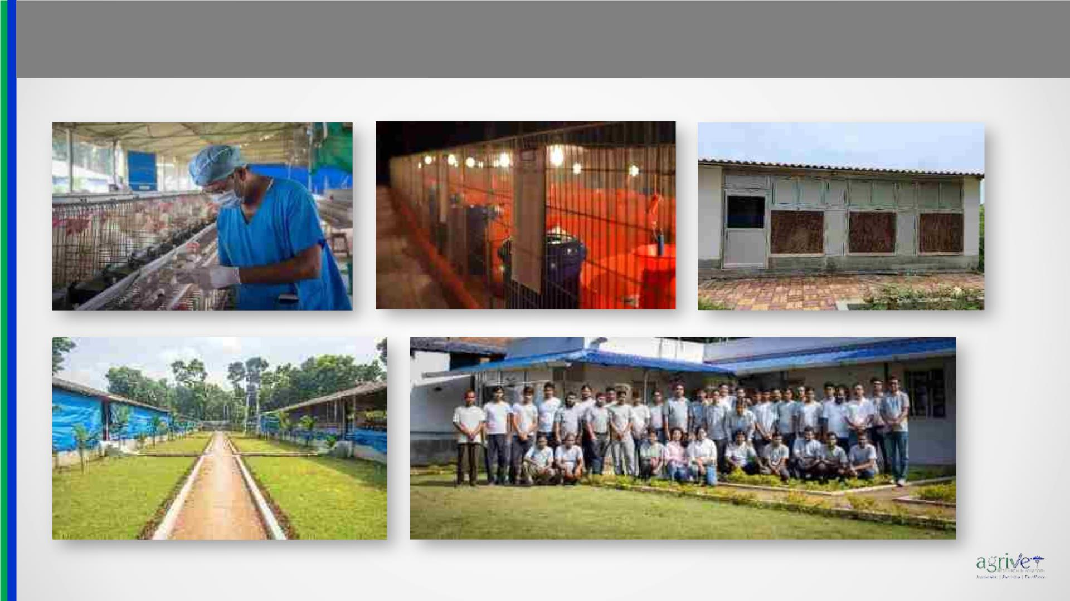
Infrastructure Overview
www.agrivet.in

Slide 31
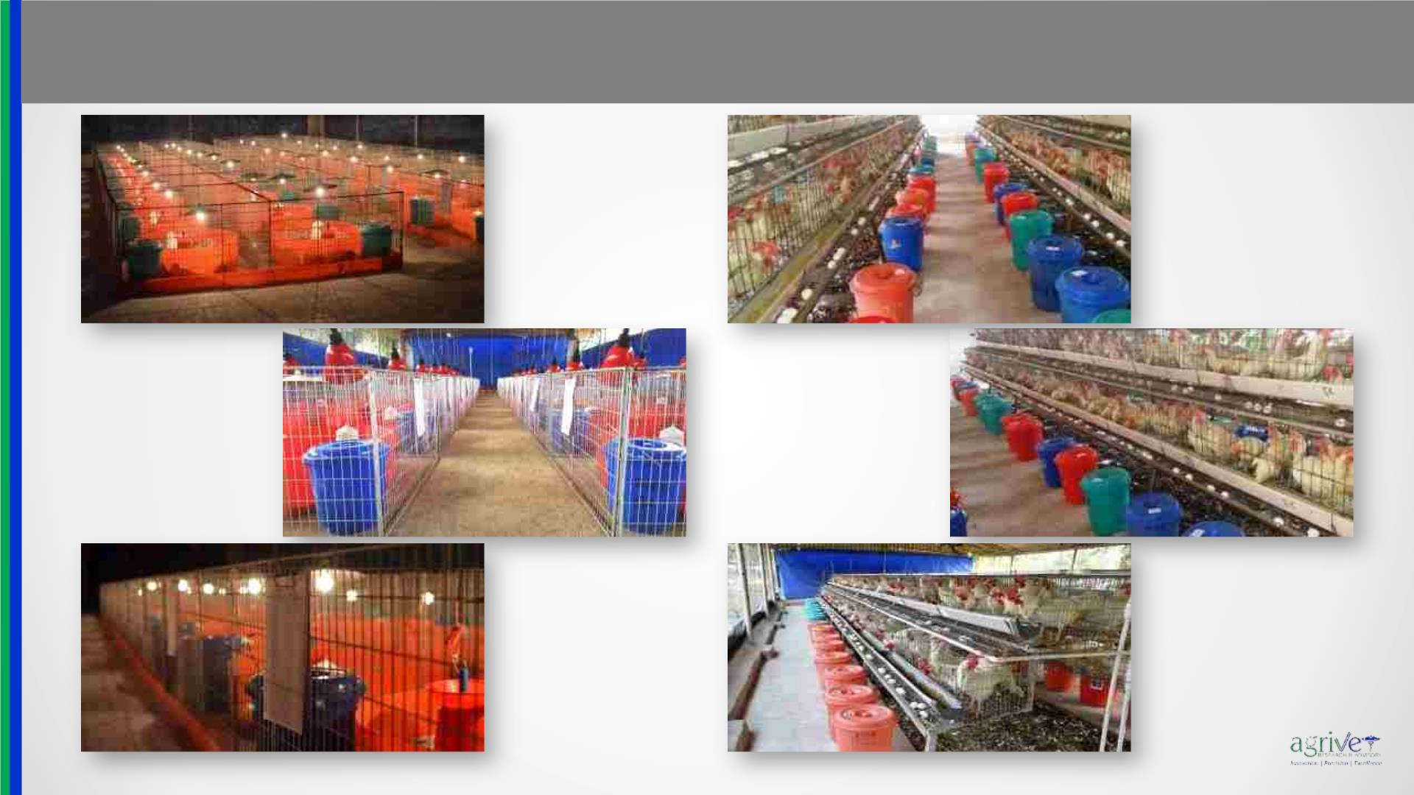
Infrastructure Overview
www.agrivet.in

Slide 32
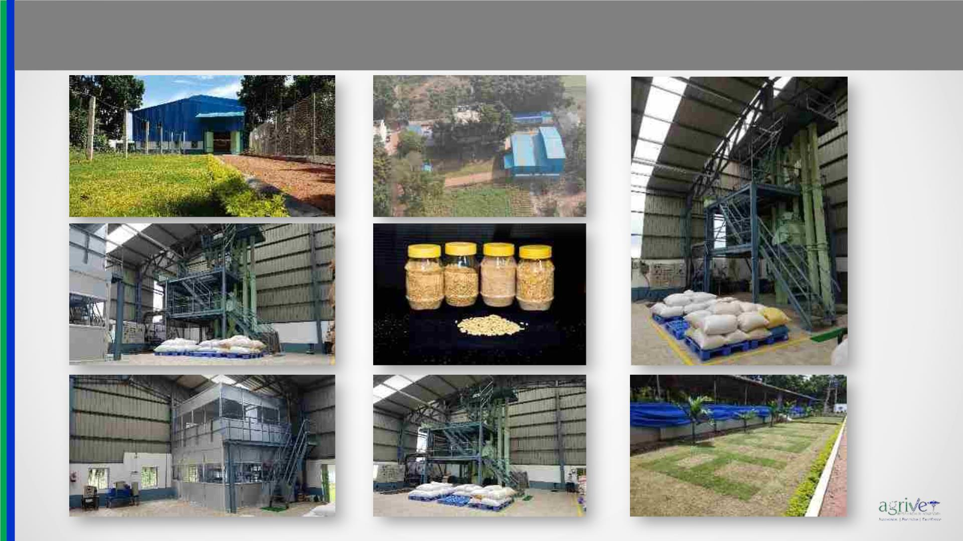
Infrastructure Overview
www.agrivet.in

Slide 33
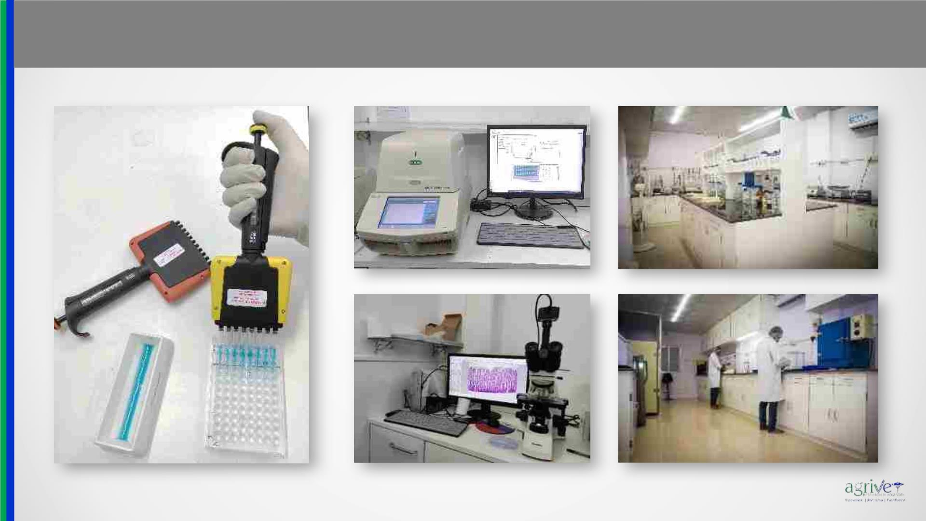
Infrastructure Overview
www.agrivet.in

Slide 34
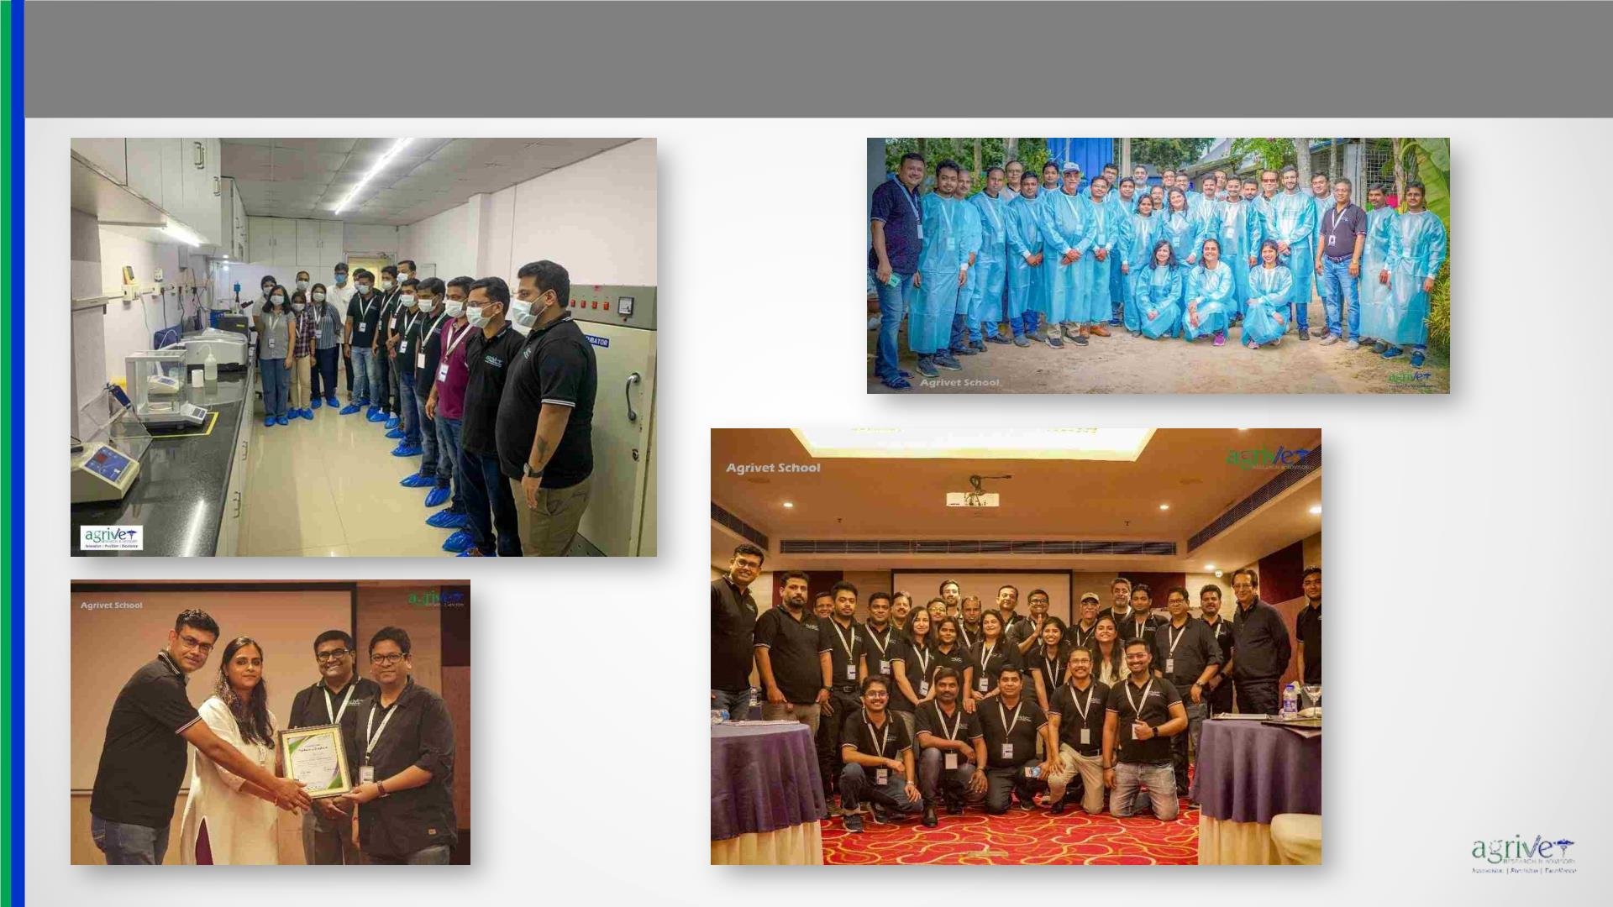
Infrastructure Overview
www.agrivet.in

Slide 35

Selected Scientific Publications
www.agrivet.in
Sudipto Haldar*, Anirvid Sarkar, Amrita Dhara, Shivaji Dey. Effects of dietary supplement of natural calcium and phosphorus bioavailability enhancer (MagaCal) on
performance, bone mineralization and serum calcium binding protein activity (Calbindin D9K) in broilers. Proceedings of IPPE 2022, Atlanta, USA
David Diez^{*1}, Julia Pie¹, Anna Tesouro¹, Sudipto Haldar², Amrita Dhara². Natural prevention of coccidiosis and necrotic enteritis in experimentally infected broilers.
Proceedings of IPPE 2022, Atlanta, USA
Mohiuddin Amirul Kabir Chowdhury, Amrita Kumar Dhara, Shivaji Dey, Anirvid Sarkar,Sudipto Haldar, Glenmer Bathan Tactacan. Protease Complex Reduces Potentially
Pathogenic Microbial Populations in the Ileum While Optimizing Performance of Broiler Chickens. Animal and Veterinary Sciences. Vol. 9, No. 1, 2021, pp. 16-23. doi:
10.11648/j.avs.20210901.13
Chowdhury MAK, Dhara AK, Dey S, Sarkar A, Tactacan BT, Haldar S. (2021). Dietary supplementation of a microencapsulated essential oil-organic acid blend with and
without a protease affects performance, nutrient accretion, cecal microbiota and circulatory biomarker concentrations in male broiler chickens. Letters in Animal
Biology 01(01): 19 – 33.
A Dhara, D Verma, S Dey, A Sarkar and S Haldar. (2019) Assessment of tributyrin as a replacement for antibiotic growth promoters in broiler diets: effects on
performance, selected bacterial population in digesta, intestinal histomorphology and immune responses (measured through vaccine titres). Acta Scientific Veterinary
Sciences 1: 22-31.
Pathak, M., Mandal, G. P., Patra, A. K., Samanta, I., Pradhan S. and Haldar, S. (2016) Effects of dietary supplementation of cinnamaldehyde and formic acid on growth
performance, intestinal microbiota and immune response in broiler chickens. Animal Production Science. http://dx.doi.org/10.1071/AN15816
Toshi Wati, Ghosh, T. K., Syed, B. and Haldar, S (2015) Comparative efficacy of a phytogenic feed additive and an antibiotic growth promoter on production
performance, caecal microbial population and humoral immune response of broiler chickens inoculated with enteric pathogens. Animal Nutrition 1: 213-219.
Singh A.K., Ghosh, T.K., Creswell, D. and Haldar, S (2015) Effect of supplementation of betaine hydrochloride on physiological performance of broilers exposed to
thermal stress. Open Access Animal Physiology. Doi.10.2147/OAAP.S83190.

Slide 36
Selected Scientific Publications
www.agrivet.in
Murugesan, G. R., Syed, B., Haldar, S and Pender C. (2015) Phytogenic feed additives as an alternative to antibiotic growth promoters in broiler chickens. Frontiers in
Veterinary Science. Doi. 10.3389/fvets.2015.00021.
Singh AK’ Ghosh TK and Haldar S. (2015) Effects of methionine chelate- or yeast proteinate-based supplement of copper, iron, manganese and zinc on broiler growth
performance, their distribution in the tibia and excretion into the environment. Biological Trace Element Research. DOI 10.1007/s12011-014-0222-2.
Singh, A., Walk, C., Ghosh, T.K., Bedford, M.R. and Haldar, S (2013) Effect of a novel microbial phytase on production performance and tibia mineral concentration of
broiler chickens fed low calcium diets. British Poultry Science 54: 206-215.
Singh, A., Masey O’Nell, H.V., Ghosh, T.K., Bedford, M.R. and Haldar, S (2012) Effects of xylanase supplementation on performance, total volatile fatty acids and
selected bacterial population in caeca, metabolic indices and peptide YY concentrations in serum of broiler chickens fed energy restricted maize-soybean based diets.
Animal Feeds Science and Technology 177: 194-203.
Ghosh, T.K., Haldar, S Bedford, M.R., Muthusami, N. and Samanta, I. (2012) Assessment of yeast cell wall as replacements for antibiotic growth promoters in broiler
diets: effects on performance, intestinal histo-morphology and humoral immune responses. Journal of Animal Physiology and Animal Nutrition 96: 275-284.
Haldar, S Ghosh, T.K., Toshiwati and Bedford M.R. (2011) Effects of yeast (Saccharomyces cerevisiae) and yeast protein concentrate on production performance of
broiler chickens exposed to heat stress and challenged with Salmonella enteritidis. Animal Feed Science and Technology 168: 61-71.
Muthusamy, N., Haldar, S, Ghosh, T.K. and Bedford, M.R. (2011) Effects of hydrolysed Saccharomyces cerevisiae yeast and yeast cell wall components on live
performance, intestinal histo-morphology and humoral immune response of broilers. British Poultry Science 52: 694-703.
Samanta, S., Haldar, S. and Ghosh, T.K. (2010) Comparative efficacy of an organic acid blend and bacitracin methylene disalicylate as growth promoters in broiler:
effects on performance, gut histology and small intestinal milieu. Veterinary Medicine International (Published online doi:10.4061/2010/645150).
Bahadur, V., Haldar, S. and Ghosh, T.K. (2010) Assessment of the efficacy of L-lysine sulfate vis-à-vis L-lysine hydrochloride as sources of supplemental lysine in
broiler chickens. Veterinary Medicine International (Published online doi:10.4061/2010/964076).

Slide 37
Selected Scientific Publications
www.agrivet.in
Mondal, S., Haldar, S., Saha, P. and Ghosh, T.K. (2010) Metabolism and tissue distribution of trace elements in broiler chickens fed diets fed deficient and plethoric
levels of copper, manganese and zinc. Biological Trace Element Research 137: 190-205.
Roy, A., Haldar, S., Mondal, S. and Ghosh, T.K. (2010) Effects of Supplemental exogenous emulsifier on performance, nutrient metabolism, and serum lipid profile in
broiler chickens. Veterinary Medicine International (Published online doi:10.4061/2010/262604).
Samanta, S., Haldar, S., Bahadur, V. and Ghosh, T.K. (2008) Chromium picolinate can ameliorate the negative effect of heat stress and enhance performance, carcass
and meat traits in broiler chickens by reducing the circulatory cortisol level. Journal of the Science of Food and Agriculture 88: 787-796.
Haldar, S., Samanta, S., Banerjee, R., Sharma, B. and Ghosh, T.K. (2007) Glucose tolerance and serum concentrations of hormones and metabolites in goats (Capra
hircus) fed diets supplemented with inorganic and organic chromium salts. Animal 1: 347-356.
Haldar, S., Ghosh, T.K., Pakhira, M.C and De, K. (2006) Effects of incremental dietary chromium (Cr3+) on growth, hormone concentrations and glucose clearance in
growing goats (Capra hircus). Journal of Agricultural Science (Cambridge) 144: 269-280
Amatya, J. L., Haldar, S. and Ghosh, T. K. (2005) In vitro uptake of chromium from inorganic and organic sources across everted intestinal sacs of poultry. Indian Journal
of Animal Sciences 75: 680-684.
Ahmed, N, Haldar, S., Pakhira, M. C. and Ghosh, T.K. (2005) Growth performances, nutrient utilization and carcass traits in broiler chickens fed with a normal and a low
energy diet supplemented with inorganic chromium (as chromium chloride hexahydrate) and a combination of inorganic chromium and ascorbic acid. Journal of
Agricultural Science (Cambridge) 143: 427-439

Slide 38

Popular Articles
www.agrivet.in
S. Haldar (20) Practical solutions for water quality issues – Part 1: Water availability and disease transmission. Asian Poultry: 8-10
S. Haldar (2020) Practical solutions for water quality issues – Part 2: Microbial and chemico-physical standards. Asian Poultry: 12-16.
S. Dey, AK Dhara, A Sarkar and S Haldar (2016) Utilising cotton seed meal in broiler diets. Asian Poultry: 42-45.
S. Agarwal, S. Saxena and S. Haldar (2017) A novel enzyme-DFM combination helps to improve broiler performance under cyclic heat-stress condition. Livestock and Feed
Business:40-42.
D. Creswell and S. Haldar (2015) Utilising roasted guar meal in broiler diets. Asian Feed Magazine: 30-33.

Slide 39

Presentation
www.agrivet.in
Year
Venue
Conference/Symposia
Title of presentation
Presenter
February 2023 Jabalpur, Madhya Pradesh WVPA (India) Conference
Modulation of the Microbiota–Gut–Brain Axis – The future
strategy to augment poultry productivity in future
Digging into the gut-brain axis to enhance poultry
performance: the role of GABA as a game changer
Technological Approach for a Sustainable Future of Poultry
Business
Sudipto Haldar
Sudipto Haldar
February 2023
Kolkata, India
NOVACON 2023
Anirvid Sarkar
Anirvid Sarkar
Anirvid Sarkar
September, 2022
August, 2022
Kolkata, India
Kolkata, India
AgriGate 2022
Innovation & Technology in Indian AgriTech Startups
Indian Poultry Review Annual Conclave 2022
Challenges to the Poultry Industry & Technological Approach
for a Sustainable Future
Sudipto Haldar
Amrita K Dhara
Adisseo Technical Summit, 2023
February, 2022
March 2021
World Veterinary Day Seminar in Kolkata organized
by EW Nutrition, 2022
Sudipto Haldar
Sudipto Haldar
Bengaluru, India
Hyderabad, India
Online Discussion Forum: Poultry Feeding Trends The art of fetching the optimum performance with
by CPDO&TI, Bengaluru minimum cost
National webinar on: Entrepreneurial
Opportunities in Rural Poultry, at ICAR –
Directorate of Poultry Research, Hyderabad
National Webinar on: Backyard Poultry: An
Business plan, Economics and Marketing opportunities in
Rural Poultry
November 2020
October 2020
Anirvid Sarkar
Anirvid Sarkar
West Bengal, India
Opportunistic Rural Venture for Employment andTrends & Opportunities for Marketing and Business
economy for Backyard Poultry & Poultry Products
Empowerment at Uttar Banga Krishi
Viswavidyalaya
January, 2020
Bengaluru, India
Kolkata, India
Interactive session with Marketing Frontrunners:
Natural remedies
Trouble shooting in poultry nutrition
Sudipto Haldar
Sudipto Haldar
International Conference on Animal Nutrition
organized by Animal Nutrition Society of India
Removing antibiotics from poultry diets for a better future:
implications and strategies to minimise the subsequent
problems
December, 2019

Slide 40

Presentation
www.agrivet.in
Year
Venue
Conference/Symposia
Title of presentation
Presenter
Winter School organised by Indian Council of
Agricultural Research and University of Animal Basics of Poultry Feed Formulation
and Fishery Sciences
September, 2019
Kolkata, India
Sudipto Haldar
August, 2019
August, 2019
February, 2019
June 2019
Bangkok, Thailand
Jakarta, Indonesia
Broiler Feed Quality Conference
Practical solutions for water quality issues
Recent Trends in Poultry Nutrition
Sudipto Haldar
Sudipto Haldar
Sudipto Haldar
Dhaka, Bangladesh
Bhubaneswar, India
Technical Seminar organized by AB Vista South
Asia
Indian Poultry Review Annual Conclave
Unconventional raw materials in broiler diets… Do they
really reduce costs?
Biratnagar & Kathmandu,
Nepal
Technical seminar organized by Ravioza Biotech Role of management in producing antibiotic free chicken
Sudipto Haldar
Amrita Kumar Dhara
April, 2019
Kolkata, India
Directorate of Research, Extension & Farms,
WBUAFS
Viral diseases of poultry with special emphasis on gross
pathology, diagnosis, transmission, prevention & control
Evaluation of a new generation intrinsically heat stable
Amrita Kumar Dhara
July, 2018
San Antonio, Texas
Poultry Science Association Annual Meeting
2018
phytase at different levels of inclusion on performance and
tibia ash contents of broiler chickens
Sudipto Haldar
Understanding the chicken gut microbiota – an insight into
the factors leading to a healthy gut
Sudipto Haldar
Sudipto Haldar
Sudipto Haldar
October, 2018 Kuala Lumpur, Malaysia
Distributor Training Program organized by
Natural Remedies
Understanding the gut health of poultry – an insight into the
factors leading to a healthy gut
Technical training program for poultry
professionals of Nepal organised by Nepal
Veterinary Organization
A good quality protein meal pays dividend: Be critical
while selecting the protein source
November, 2018
Chitwan, Nepal
Trace mineral nutrition of Poultry
Sudipto Haldar
Quality overview and analysis of raw materials
Aivan Priyadarshi

Slide 41

Presentation
www.agrivet.in
Year
Venue
Conference/Symposia
Title of presentation
Basics of Poultry Feed Formulation
Critical look at protein meals
Presenter
May, 2018 Kathmandu, Nepal
Poultry Nutrition and Feed Formulation
Workshop: US Soybean Export Council
Sudipto Haldar
Sudipto Haldar
September, 2018 Chandigarh, India
March, 2017 Bangkok, Thailand
May, 2017 Dhaka, Bangladesh
Technical Seminar organized by Rossari
Biotech Ltd
Gut health drives performance in poultry… An insight into the factors
leading to a healthy gut
Sudipto Haldar
Sudipto Haldar
Sudipto Haldar
Sudipto Haldar
Sudipto Haldar
Sudipto Haldar
Sudipto Haldar
Sudipto Haldar
Poultry Innovation Summit Asia 2017
organized by Ceva Sante Animale
Technical Seminar organized by Guybro
Chemicals
Surfactant technology for efficient feed production
Organic Trace minerals – the key to extract the most from your flock
September, 2017
Jakarta, Indonesia Technical Seminar Organised by Novus
Hyderabad, India International
How to use enzymes and their matrix values in poultry feed
formulations
October, 2017 New Delhi, India Biomin Asia Nutrition Forum
Feed converter – the gift from a Healthy gut - An insight into the
factors leading to a healthy gut
Raising broiler chickens in an antibiotic free era…the myths and the
myth busters
August, 2017 Bangkok, Thailand Broiler Feed Quality Conference
Unconventional raw materials in broiler diets – do they really reduce
cost?
July, 2016
Pune, India
Technical Symposium organised by Indian
Herbs
Gut health drives performance in poultry…
An insight into the factors leading to a healthy gut
July, 2016 Biratnagar, Nepal Technical seminar organised by Asian Feeds Broiler management in tropical climate
November, 2016 Agartala, Tripura Technical seminar organised by Mountt Agro Broiler management & disease in tropical climate
Pre-Conference Satellite Symposium organised
Amrita Kumar Dhara
Amrita Kumar Dhara
August, 2015 Bangkok, Thailand
BY DSM at BFQC
Formulating broiler diets for least cost and maximum performance
Sudipto Haldar
April, 2015 Biratnagar, Nepal Technical seminar organised by Asian Feeds Common broiler problems encounter in tropical climate
Amrita Kumar Dhara
BOKU (University of Natural Resources and
Life Sciences)
Effects of a phytogenic feed additive on growth performance,
nutrient digestibility, caecal microflora composition and intestinal
histomorphology of broilers
Presented in
abse
April, 2014
Vienna, Austria

Slide 42

Participation in Conference/Symposia
www.agrivet.in
Year
March, 2023
Conference / Symposium
Location
VIV Asia 2023
Bangkok, Thailand
KIPF 2023
Kolkata International Poultry Fair
Kolkata, India
November, 2022
February, 2020
November, 2019
July, 2019
Poultry Knowledge Day – Poultry India
World Veterinary Poultry Association Conference
Poultry Knowledge Day – Poultry India
PSA Annual Meeting
Hyderabad, India
Bangalore, India
Hyderabad, India
Montreal, Canada
Kuala Lumpur, Malaysia
Bangkok, Thailand
Bangkok, Thailand
Dhaka, Bangladesh
Hyderabad, India
Kuala Lumpur, Malaysia
Phuket, Thailand
Raleigh, USA
July, 2019
Technical Symposium – “Nutrition & Gut Health Management in High Performing Animals”.
World Veterinary Poultry Association Congress
VIV Asia 2019
September, 2019
March, 2019
March, 2019
November, 2018
October, 2018
September, 2018
July, 2018
11th International Poultry Show & Seminar 2019
Poultry Knowledge Day – Poultry India
World Veterinary Poultry Association Asia Conference
Poultry Panorama
Visit to Poultry Research Facility of North Carolina State University
VICTAM Asia 2018
March, 2018
November, 2017
September, 2017
August, 2017
August, 2017
June, 2017
Bangkok, Thailand
Hyderabad, India
Mumbai, India
Poultry Knowledge Day – Poultry India
Golden Jubilee Celebration of CLAFMA of India
Broiler Feed Quality Conference
Bangkok, Thailand
Kolkata, India
Advanced Feed Mill Management Symposium
Asia Pacific Summit on Feed Enzymes in Animal Nutrition
AAFAN 2017 (Amino Acid Forum in Animal Nutrition)
VIV Asia 2017
Bangkok, Thailand
Beijing, China
June, 2017
March, 2017
Bangkok, Thailand

Slide 43

Participation in Conference/Symposia
www.agrivet.in
Year
December, 2016
November, 2016
August, 2016
August, 2016
July, 2016
Conference / Symposium
Location
Hyderabad, India
Seminar of Arm & Hammer
Poultry Knowledge Day – Poultry India
Broiler Feed Quality Conference
Hyderabad, India
Bangkok, Thailand
Hyderabad, India
New Orleans, USA
Stayerhofweg, Netherlands
Atlanta, USA
Best Technical Service Provider Award – 2016 at Poultry CEO’s Forum by Poultry Fortune
PSA Annual Meeting
April, 2016
Visit to “Feed Design Lab”
January, 2016
November, 2015
September 2015
August, 2015
May, 2015
The International Production & Processing Expo
Poultry Knowledge Day – Poultry India
Poultry Feed Quality Conference
Hyderabad, India
Bangkok, Thailand
Goa, India
ResCom Summit
Alltech REBELation
Lexington, USA
July, 2015
Technical Symposium Conducted by MSD Animal Health
VIV Asia 2015
Malacca, Malaysia
Bangkok, Thailand
Bangkok, Thailand
Hyderabad, India
Munich, Germany.
Penang, Malaysia
Queenstown, New Zealand
Colombo, Sri Lanka
Bangkok, Thailand
March, 2015
March, 2015
November, 2014
October, 2014
June, 2014
Novus Feed Technology Seminar
Poultry Knowledge Day – Poultry India
The World Nutrition Forum
Technical Symposium Conducted by MSD Animal Health
International Poultry Broiler Nutritionist's Conference
Alltech South Asia Poultry Nutrition Summit 2013
VIV Asia 2013
April, 2014
December, 2013
March, 2013

Slide 44
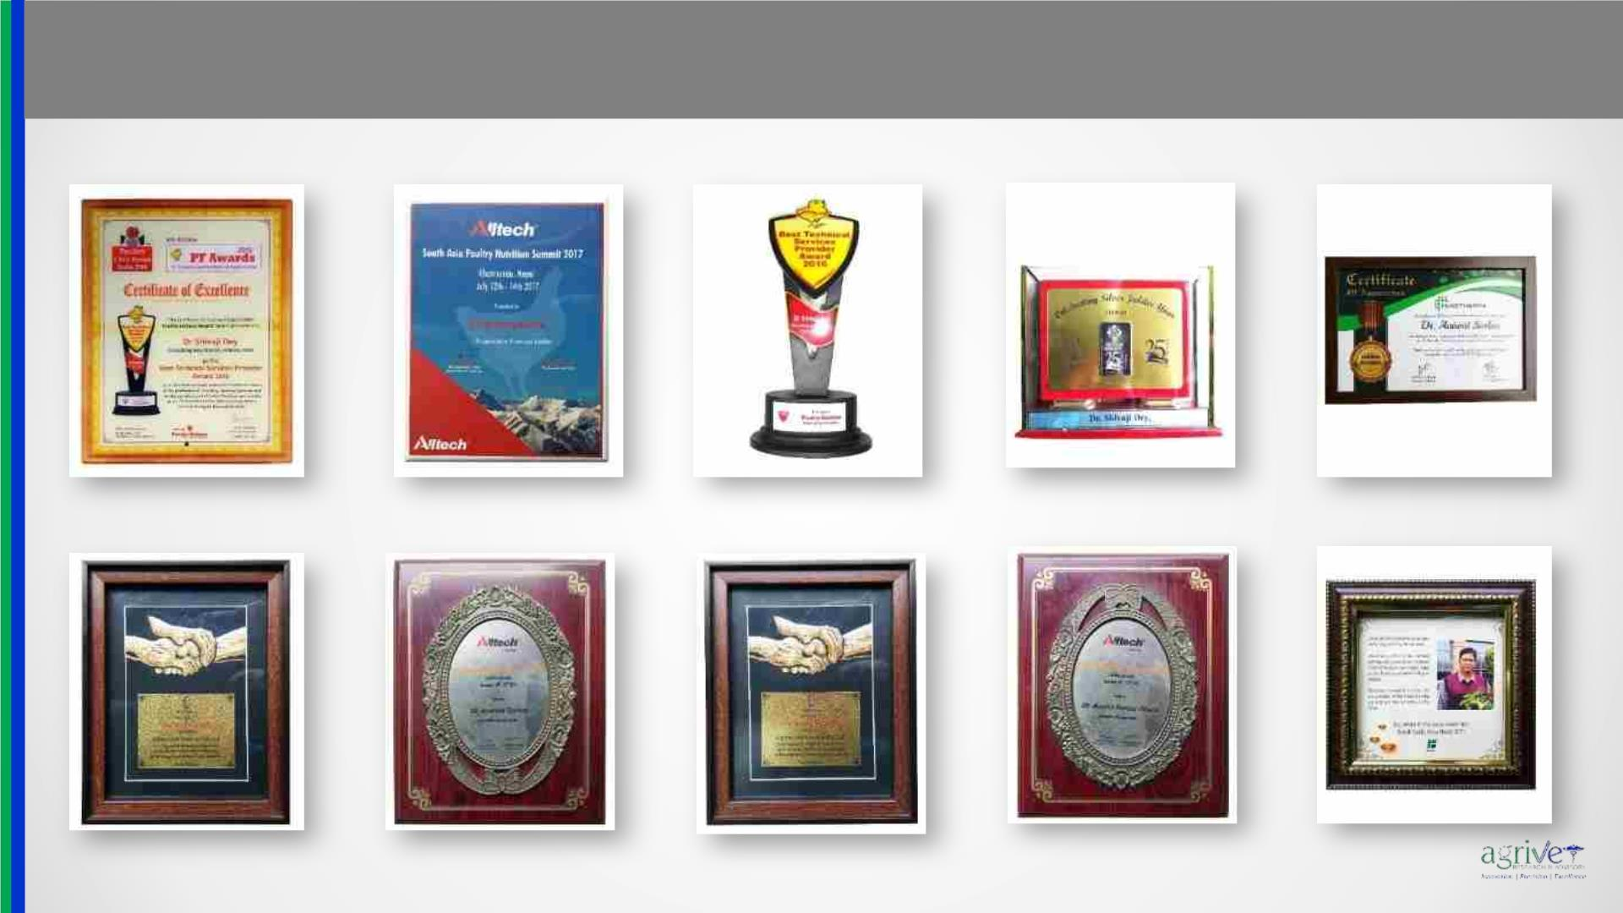
Recognition
www.agrivet.in

Slide 45
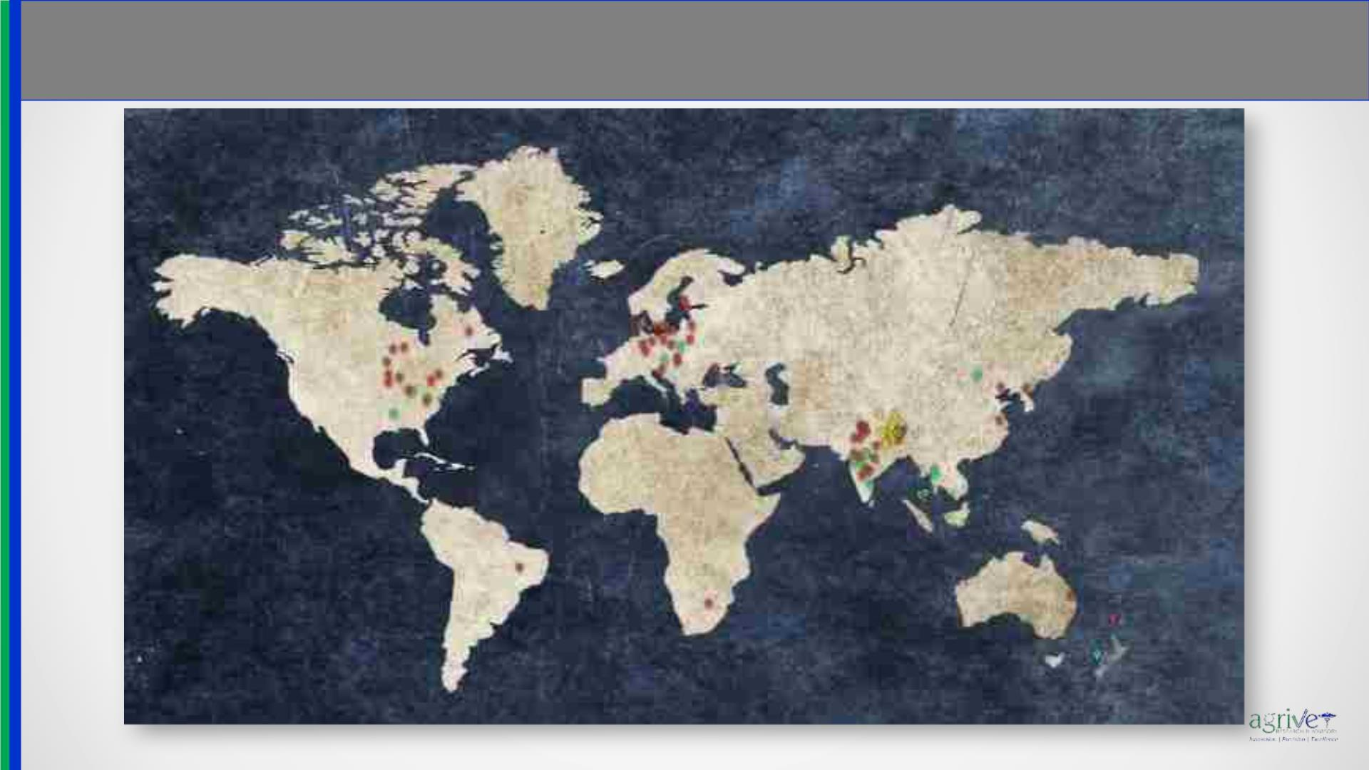
Footprint
www.agrivet.in

Slide 46

www.agrivet.in
Partners

Slide 47

THANK YOU
www.agrivet.in

