Slide 1

Agrivet Laboratories
Agrivet Research & Advisory Private Limited
(Formerly known as Agrivet Consultancy Pvt. Ltd.)
www.agrivet.in

Slide 2

Laboratory facilities
www.agrivet.in
Agrivet Research & Advisory Private Limited delivers wide array of laboratory services to its clients. Offerings of
AGRIVET LABORATORIES span from traditional Wet Chemistry, Microbiological, Serological and Biochemical
techniques to modern cutting-edge Metagenomics and Transcriptomics.
Nutritional Profiling
• Well-equipped laboratory set-up
• Laboratory is primarily developed for R&D
activities
• Wide array of services under one roof
• Highly qualified, skilled & dedicated laboratory
personnel
• High precision techniques and processes
• Quick TAT for analysis and result delivery
• Interpretation of test results
Microbiology
Pathology & Parasitology
Serology / Immunology
Biotechnology
Biochemistry
• Report is validated by domain experts
• IoT based Test Request and online reporting
Feed Technology
Molecular Biology
2

Slide 3

Nutritional Profiling
www.agrivet.in
ARAPL offers Nutritional Chemical Profiling of all Compound Feeds
and Raw Materials using Fully Automatic Wet Chemistry Techniques
as well as Near Infra-Red Spectroscopy (NIRS).
Proximate Analysis
Digestible Amino Acids
Calcium and total phosphorus analysis
Analysis of Peroxide Value, Rancidity and Free Fatty Acid of oil
PSI/KOH Solubility, Urease activity, NPN, Pepsin Digestibility, TVBN
Water analysis of pH, TDS, Total Hardness as Calcium carbonate
3

Slide 4
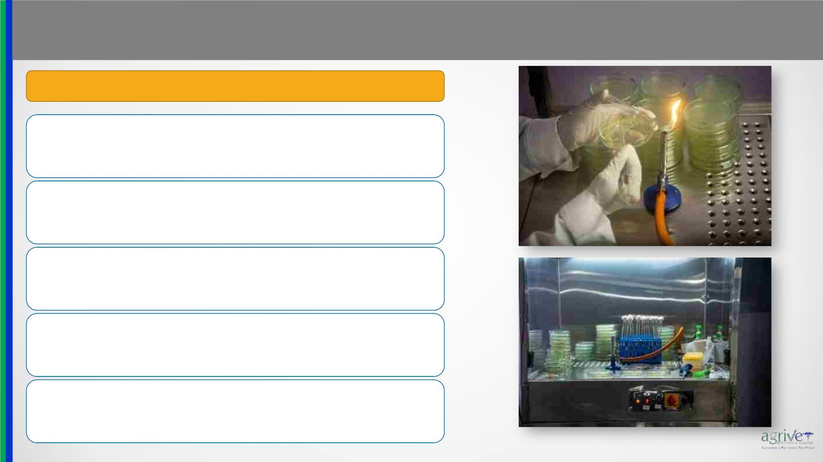
Microbiology
www.agrivet.in
Microbial diagnosis using conventional laboratory techniques
Microbiological identification and quantification of Salmonella sp.,
Escherichia coli, Clostridium sp., Total Coliforms, Total Bacterial
Count, Total Mold Count and Enterobacteriaceae
Antibiotic sensitivity test using plate test from biological samples
Complete Feed Hygiene & Water Microbiology
Rapid plate test for M. gallisepticum, M. synoviae, Salmonella
pullorum
Poultry Farm, Hatchery and Feed Mill Hygiene Management
Package
4

Slide 5
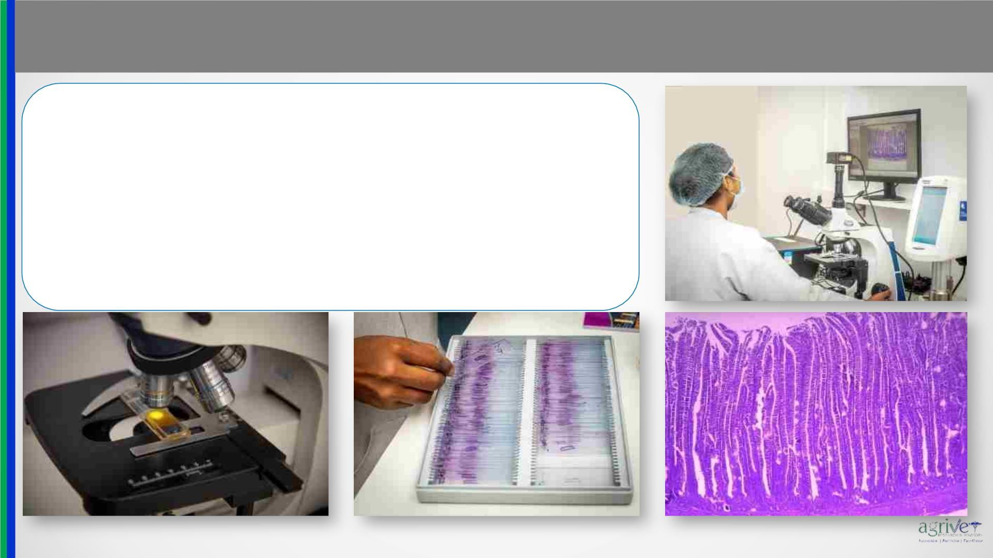
Pathology & Parasitology
www.agrivet.in
• Despite the priority of modern techniques, histopathology is a reliable
and economically reasonable method & can often lead to conclusive
diagnosis.
• Histomorphometry and histopathology study of tissues and internal
organs
• Post-mortem examination of poultry birds
• Diagnosis of the most common health issues of poultry birds
• Clinical correlation of histopathological lesions
• Coccidia oocyst count from Faecal samples
5

Slide 6
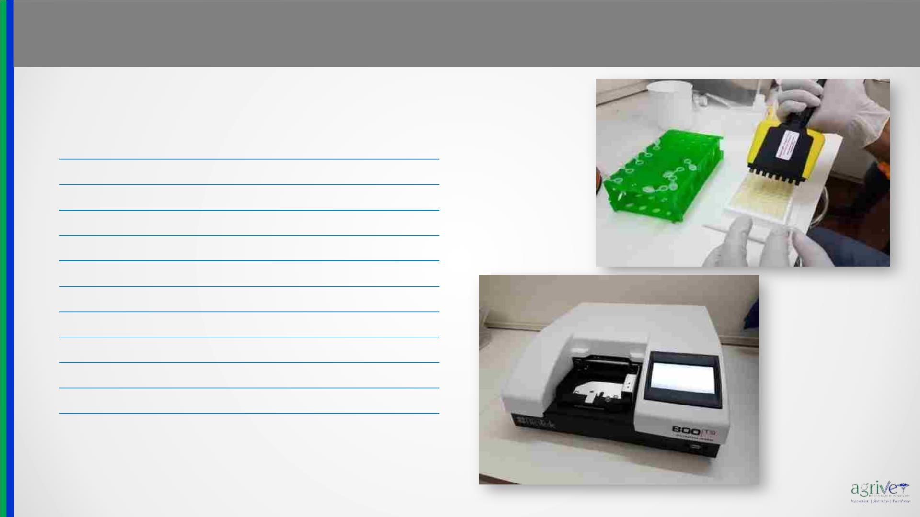
Serology / Immunology
www.agrivet.in
Wide range of Serological Assays are performed for the detection and
diagnosis of various infectious agents from the blood/serum of Poultry
using ELISA technique.
Infectious Bursal Disease
Newcastle Disease
Infectious Bronchitis
Mycoplasma gallisepticum
Mycoplasma synoviae
Avian Encephalomyelitis
Avian Leucosis Complex
Avian Pneumo Virus
Chicken Infectious Anaemia Virus
Egg Drop Syndrome
Adeno Virus (Inclusion Body Hepatitis-IBH)
Canine, Feline, Ruminant, Swine and Equine tests are also performed₆

Slide 7
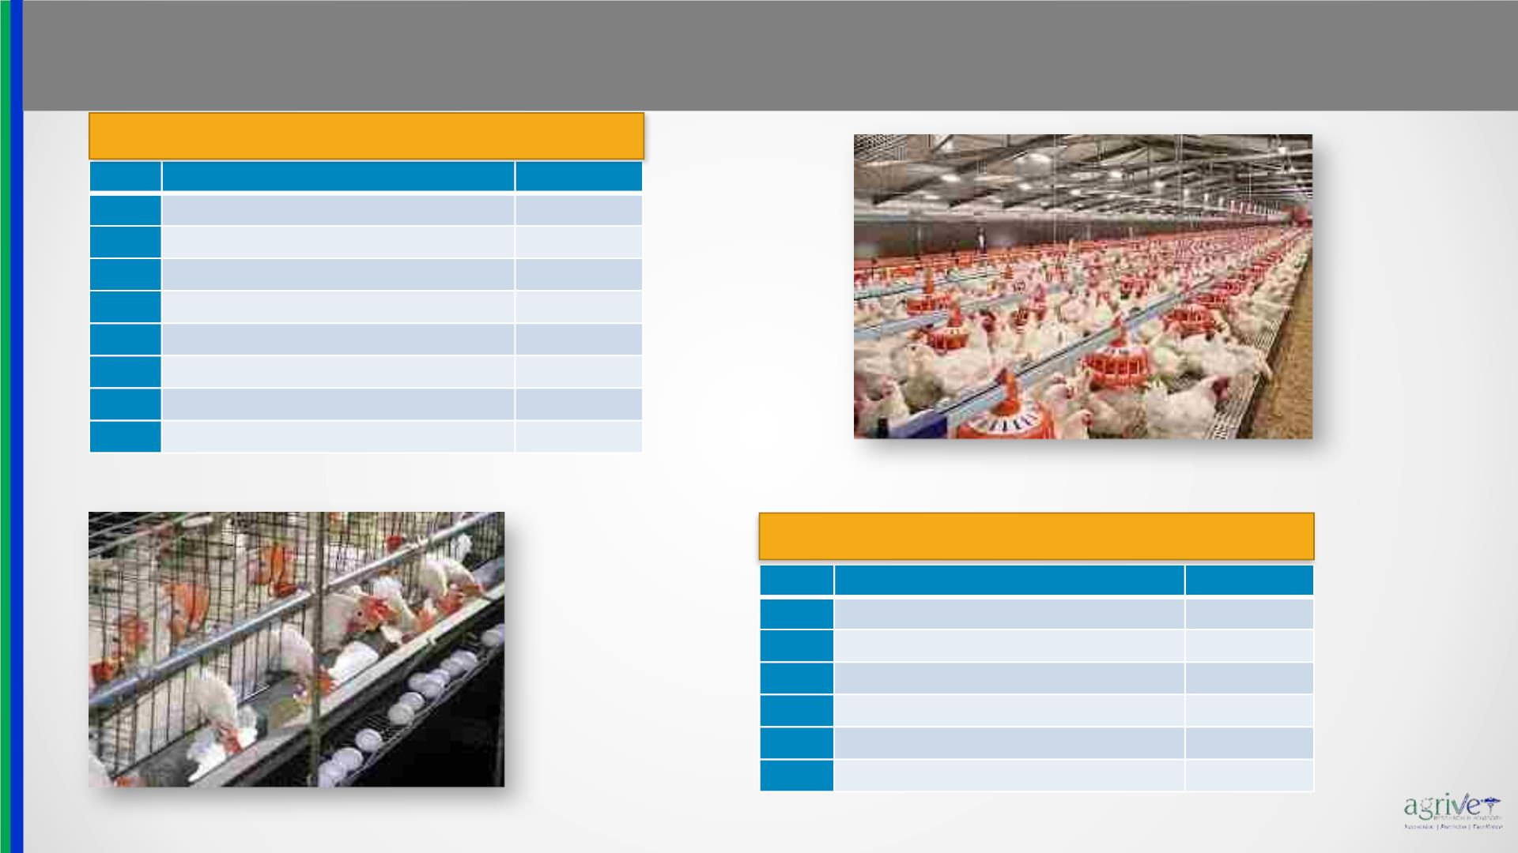
Serology / Immunology
www.agrivet.in
BREEDER SEROLOGY PACKAGE
Sl No
Antibody titre against
Newcastle disease
Infectious bronchitis
ELISA Kit
IDEXX kit
IDEXX kit
IDEXX kit
IDEXX kit
IDEXX kit
IDEXX kit
ID vet kit
1
2
3
4
5
6
7
8
Mycoplasma gallisepticum
Mycoplasma synoviae
Infectious bursal disease
Avian Reo virus
Infectious laryngo trachitis
All 7 Antibody mentioned above As above
LAYER SEROLOGY PACKAGE
Sl No
Antibody titre against
ELISA Kit
1
2
3
4
5
6
Newcastle disease
Infectious bronchitis
IDEXX kit
IDEXX kit
IDEXX kit
IDEXX kit
ID vet kit
Mycoplasma gallisepticum
Mycoplasma synoviae
Infectious laryngo trachitis
All 5 Antibody mentioned above As above
7

Slide 8

Biotechnology
www.agrivet.in
•Modern high-end precision instrument based on lateral
flow immune assay technique.
•Basic toxin profile - Aflatoxin, Ochratoxin, T2, Fumonisin
•Advanced toxin profile - Aflatoxin, Ochratoxin, T2,
Fumonisin, Zearalenone, DON
•Individual toxin analysis
Detection of
mycotoxins from
Raw Materials &
Feed
Egg Quality
Testing using
Automatic Egg
Analyzer
•Egg Weight and grading
•Candling of Eggs
•Yolk height, Yolk color, Albumin viscosity and Haugh unit
•Egg Shell Strength and Egg Shell Thickness
•Feed ingredients containing high levels of NSP, can form
viscous digesta in the GIT, limiting broiler performance.
•Investigation of the effect of digesta viscosity on the
development of the digestive tract is required.
Intestinal
Viscosity
•Measurement of Intestinal Viscosity using hi-tech,
sophisticated digital viscometer
8

Slide 9
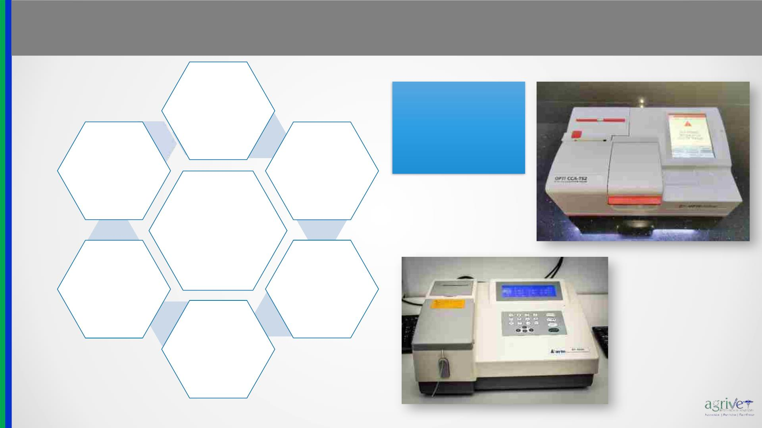
Biochemistry
www.agrivet.in
Arterial Blood Gas (ABG) Analyses:
pH, pCO , pO , Na+,
Liver function
test
2
2
K+, Ca+, Cl⁻, Lactate,
Hb, SO₂, Actual
bicarbonate,
Calcium &
Phosphorus
Kidney
function test
Hematocrit, etc.
Biochemistry
Alkaline
Phosphatase,
Gamma
Lipid profile
Glutamyl
Transferase
Glucose
9

Slide 10
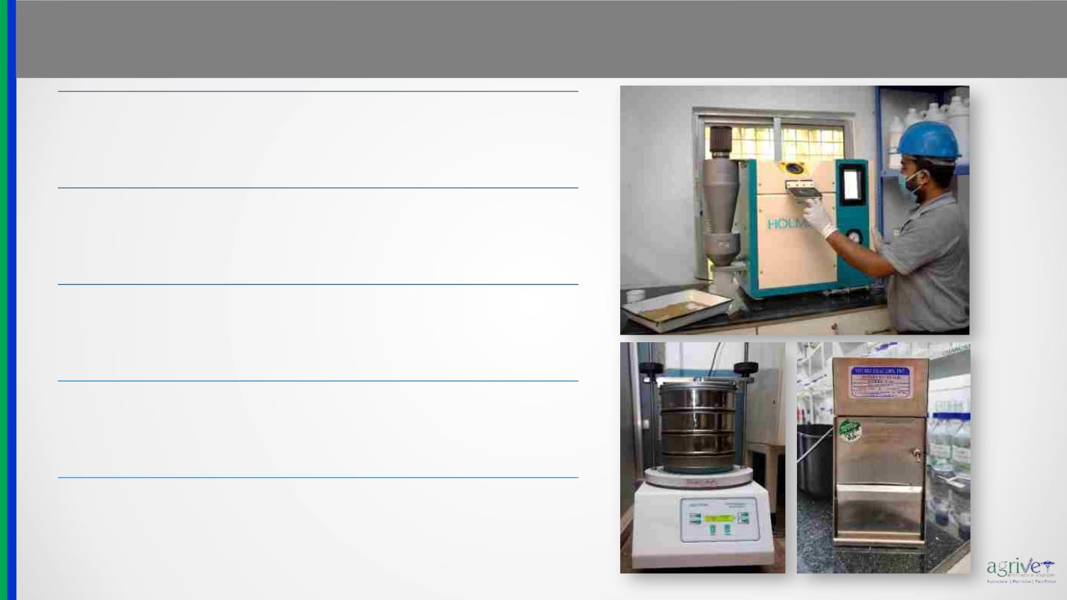
Feed Technology
www.agrivet.in
Pellet Durability Index & Pellet Hardness
Residual Fine and Texture Profiling
Pellet Dissociation using mechanical process
Mixing Uniformity Analysis (CV)
Validating Mixing Uniformity, Ingredients Tracking and
Cross-contamination Control using Magnetically
Retrievable Rotary Detector
10

Slide 11

Moving forward from conventional research….
www.agrivet.in
Traditional microbiological procedures in poultry research were extensively
based on culture techniques to isolate desirable microorganisms and
Sequencing the genome of one organism at a time for Identification
purpose.
However, only <1% of all microbes can be cultured.
Hence, these traditional techniques have left us with a biased and incredibly
incomplete understanding of the microbial flora.
These limitations and biasedness arising from traditional microbiological techniques can be overcome by the use of
metagenomics- which in a broader sense can be referred to as environmental genomics, ecogenomics or community
genomics.
11

Slide 12

Areas of Expertise
www.agrivet.in
Metagenomics of Chicken Gut Microbiome
Molecular Detection of Bacterial and Viral disease
Assessment of DNA damage and repair by Comet Assay
Transcriptomic analysis using Quantitative Real-time PCR (qRT-PCR) and RNA-seq.
Gene expression study on Poultry growth performance, immunogenetics & heat stress
Nucleic acid extraction from various samples (microbes, animal tissues, environmental samples, etc.)
Plant RAPD barcoding
12

Slide 13
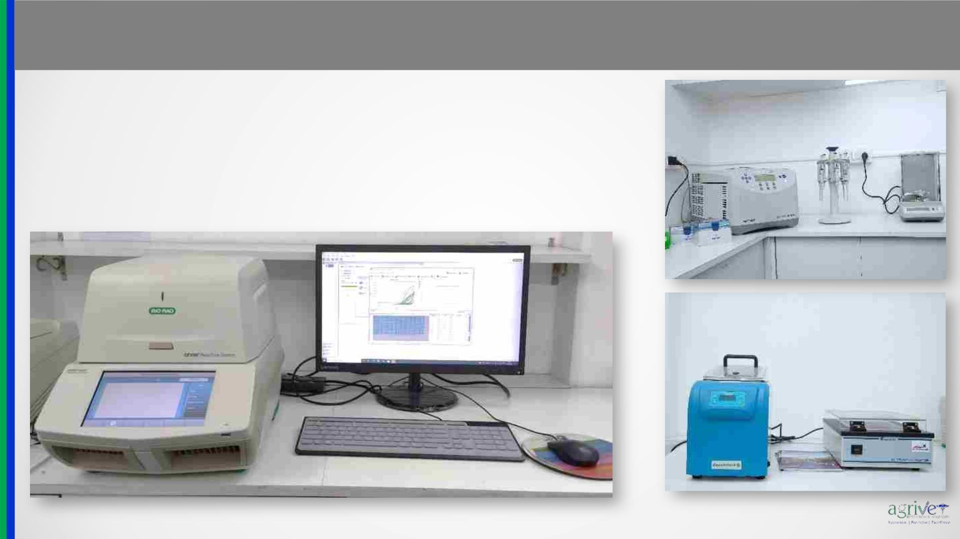
Molecular Biology
www.agrivet.in
Agrivet Laboratories offers a diverse range of cutting-edge Molecular Biology
Analysis spanning Genomics and Metagenomics as well as their application in
Molecular In Vitro Diagnosis of various pathogens of Poultry.
Agrivet Laboratories is also actively involved in Metabolomics and Transcriptomic
analysis of various gene regulations and pathways which are affected due to
differential feeding, infection, and pharmaceutical products (probiotics).
13

Slide 14
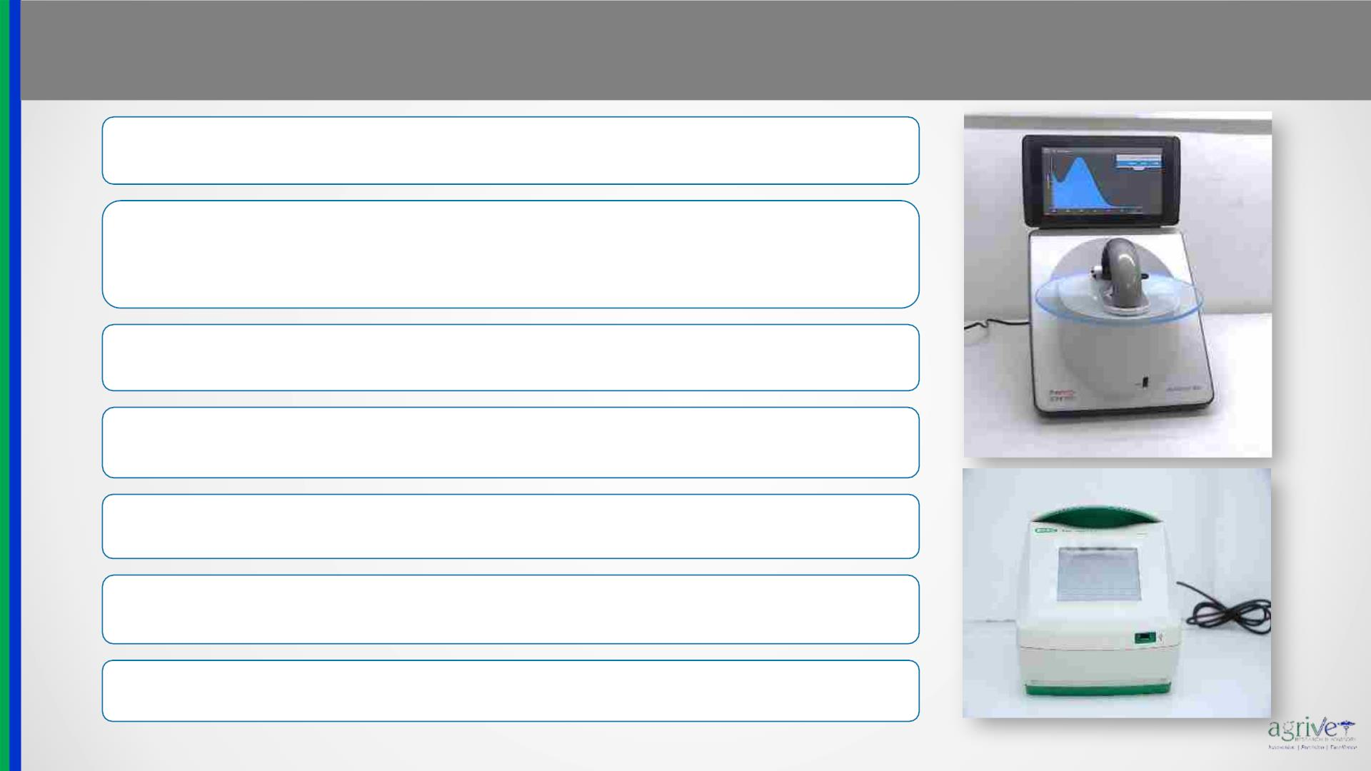
Molecular Biology
www.agrivet.in
Genomic DNA isolation from plant, animal, microbes, soil and blood to amplicon
upto 2kb
Gene expression compiled report including RNA isolation, QC, cDNA preparation
and gene expression analysis using SYBRTM Green and TaqManTM qRT-PCR
GMO testing by using CMV35S/ CRY/ NOS sequence on RT-PCR as required
Microbiome metagenomics study from poultry gut/ faeces using 16s rRNA gene
sequencing-V3-V4
Microbiome metagenomics study from poultry gut/ faeces using whole genome
shotgun metagenomics study
Bacterial molecular identification using 16S primer
Fungi molecular identification using ITS primer or 28S primer
14

Slide 15
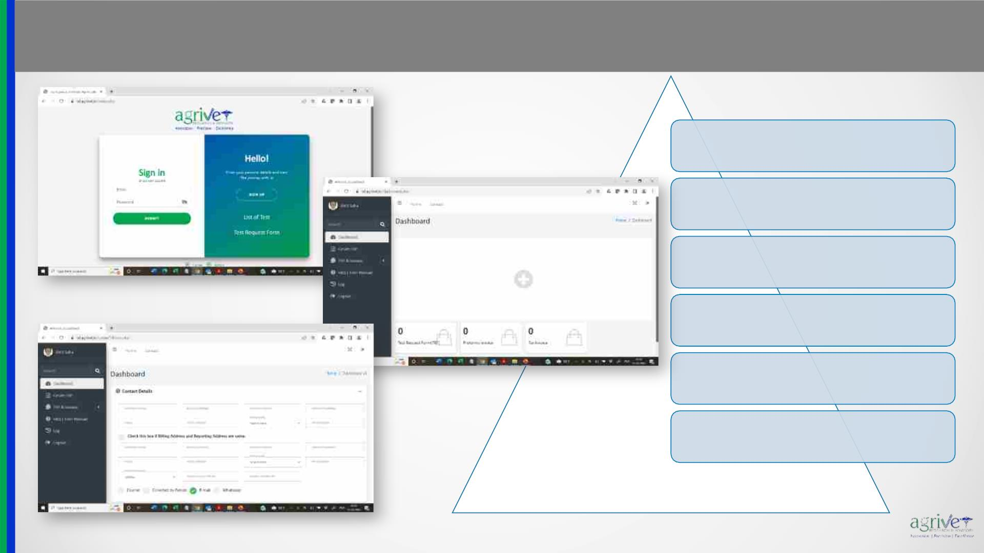
Exclusive Customer Portal
www.agrivet.in
Self Service in making Test Request
through online TRF Generator
Transparent pricing and real-time
online budget estimation
Immediate confirmation on sample
acceptance at the laboratory level
Online report access with historical
report archive facility
Instant Live Chat facility with
Laboratory coordinators
Online payment option using Credit
Card / Debit Card
15

Slide 16

Agrivet Research & Advisory Private Limited Laboratory Services
24 X 7 Helpline +91 9330022177
centrallaboratory@agrivet.in | sayantani@agrivet.in
THANK YOU
www.agrivet.in
16

